Slide 1
Topic 7:
Economic Analysis of Oligopoly and
The Agreement Requirement

Slide 2
The Modern Economics of Collusion:
Recall from Lysine Discussion
Solving “Cartel Problems”
Reaching consensus on terms of coordination;
Deterring cheating on that consensus; and
Preventing new competition, whether in the form of expansion by fringe firms that are currently rivals but not part of the coordinated arrangement or in the form of new entry.
pp. 291-92

Slide 3
Economics of Oligopoly Interdependence
Important Terminology Issue:
Economists use the term
“non-cooperative” for this “individualistic” incentive
Potential cartelists face a Prisoner’s Dilemma in setting prices
  The firms have a “mutual (cooperative) incentive” to set the cartel price that maximizes joint profits
  But, each firm has an “individualistic incentive” to
  “defect” and undercut the rival to increase market share
  Thus, tension between short-term profits from cheating vs longer-term profits from adhering to the price fix agreement.
Possible oligopoly outcomes without formal agreement
  They recognize their interdependence and their conflicting short-term incentives vs longer-term joint profits
  Unlike the prisoners who face a “one-shot” decision, oligopoly is a “repeated game”
  The oligopoly price equilibrium outcome will depend on market conditions and informational conditions (e.g., speed of detection and punishment of cheating)
The possible outcomes can range anwhere
in-between the “non-cooperative” competitive price up to cartel price
Important Terminology Issue:
Economists call all these outcomes “coordination” or “tacit collusion.”
But the economists’ “tacit collusion” term not the same as what the courts would refer to as a “tacit agreement” would satisfy the Agreement Requirement” of Section 1. it even includes “conscious parallelism”

Slide 4
Oligopoly Prisoner’s Dilemma: “Payoff Matrix”
Characterizing the Payoff “Boxes” from Firm-1’s Viewpoint
“Win/Win”
“Sucker”
Firm 2
High
Low
High
$100, $100
$20, $170
Firm 1
Low
$170, $20
$50, $50
“Lose/Lose”
“Temptation”

Slide 5
Oligopoly Prisoner’s Dilemma: “Optimal” Strategy in One-Shot Game
In a one-shot game:
Temptation (170) Dominates Win-Win (100)
Lose/Lose (50) Dominates Sucker (20)
“Win/Win”
“Sucker”
Firm 2
High
Low
High
$100, $100
$20, $170
Firm 1
Low
$170, $20
$50, $50
“Lose/Lose”
Equilibrium
“Temptation”

Slide 6
One Shot Prisoner’s Dilemma “Dominant Strategy” Definition
In the “one shot” game, cutting price is the “dominant strategy
Firm #1-Dominant strategy is cut price regardless of Firm #2’s price.
Firm 2
High
Low
High
Low
$100, $100
$20, $170
High
Firm 1
Low
$170, $20
$50, $50
“Lose/Lose”
Equilibrium

Slide 7
One Shot Prisoner’s Dilemma “Dominant Strategy” Definition
In the “one shot” game, cutting price is the “dominant strategy.
        Firm #2 has similar incentive to defect.
Firm 2
High
Low
High
Low
$100, $100
$20, $170
High
Firm 1
Low
$170, $20
$50, $50
“Lose/Lose”
Equilibrium

Slide 8
One Shot Prisoner’s Dilemma Equilibrium Outcome
In the “one shot” game,
Equilibrium Outcome is Lose/Lose outcome with payoffs ($50,$50)
Firm 2
High
Low
High
Low
High
$100, $100
$20, $170
Firm 1
Low
$170, $20
$50, $50
“Lose/Lose”
Equilibrium

Slide 9
Then, How do Cartels and Oligopolies Achieve Stable High Prices? Answer: Recognize It is a “Repeated” Game
Tit-for-Tat (TFT) quick-response pricing can deter cheating.
TFT can achieve equilibrium at Win/Win outcome with $100 payoffs
“Win/Win”
Equilibrium
Firm 2
High
Low
High
$100, $100
$20, $170
Firm 1
Low
$170, $20
$50, $50
TFT reduces/eliminates the temptation to cut price.
It also incentivizes moving from a low price to a high price if cooperation fails.
More complicated strategies also are possible, esp. if imperfect information

Slide 10
Market Structure Factors Conducive to Successful Coordination
Market structure factors can maintain win/win by undoing temptation to cheat
-- Reduce time in “temptation” box by speeding “detection” and “ response (“punishment”)
-- Reduce profits earned during period in temptation box
Mkt structure factors similarly can increase incentive to raise price
-- Allow less time in “sucker” box, so more likely to escape “lose/lose”
“Win/Win”
Equilibrium
Firm 2
High
Low
$100, $100
$20, $170
High
Firm 1
Low
$170, $20
$50, $50

Slide 11
Coordination More Likely to Succeed For Certain Market Conditions (“Structural” Factors)
Standard oligopoly checklist
  Few firms
  Product homogeneity
  Simple products
  Transparent prices
  Open (public) transactions
  Small transactions
  Small buyers
  Inelastic market demand
  Barriers to entry
  Stable demand
Commentary
  Excess capacity is a mixed bag – greater incentive to cheat; greater ability to punish (recall ADM threat in Lysine)
  Previous history of attempted collusion also suggests incentives to try again
  If multiple market interaction, punishment can occur in a separate market
  Numerous cartels have succeeded over long periods even with a large number of firms (e.g., vitamins)

Slide 12
Casebook Figure 3–1:
Casebook Version (p.306)
Some Structural Factors Facilitating or Frustrating Coordination
Casebook Table
for reference
Facilitating | Frustrating
Few firms | Many firms
Product homogeneity | Product heterogeneity
Simple products | Complex, changing products
Public (open & transparent) transactions | Private transactions
Excess capacity (multiple firms) | Excess capacity (individual firm)
Predictable demand | Unpredictable demand
Small transactions | “Lumpy” sales
Small buyers | Large buyers
Inelastic market demand | —
Low marginal costs relative to price | —
High customer switching costs | —
Prior express collusion | —
— | Vertical integration
— | Sale of complementary products

Slide 13
Leniency Program is Another Factor (p. 287)
Goal: Supercharge Prisoner’s Dilemma Incentive to Confess
Goals
  Facilitate detection of cartels
  Facilitate cartel instability and breakdown
  Deter cartel formation?
Mechanism and Provisions:
  Incentivize a conspirator to “rat out” the cartel
  Offer immunity from criminal prosecution in return for cooperation
  Offer reduced exposure to civil liability
Illustrative example
  Rhone Polenc ratted out Vitamins cartel
Success and failure:
  Leniency program has spread around the world
  But, cartels continue to form and function for long periods

Slide 14
“Market Indicia” of Successful Coordination (Win/Win)
Market Performance Indicia
  Sticky (rigid) prices despite significant changes in supply/demand
  Cycles of high prices interrupted by price wars and then sudden price increases back to high levels.
  Lockstep price changes
  Identical prices in wholesale markets with non-published prices
  Combination of high prices and excess capacity
  Prices unrelated to costs
  High prices and low marginal costs for undifferentiated products
  Stable market shares
  Systematic price discrimination against customers with more inelastic demand, despite the lack of a monopoly.
  High profits (but note that firms often collude during recessions to cushion the fall, or out of desperation)
  Successful entry by high cost entrants
But do these factors prove an illegal agreement under Section 1. What if mere “recognition of interdependence” plus “unilateral conduct” lead to these outcomes?

Slide 15
The Evolution of the Section 1 Agreement Requirement

Slide 16
Sherman Act Sec. 1
Every
  contract, combination in the form of trust or otherwise, or conspiracy,
  in restraint of trade or commerce
  among the several States, or with foreign nations,
  is declared to be illegal
The Question: What comprises an “agreement” or “conspiracy” absent a formal contract or clear agreement?

Slide 17
Air Shuttle Warm-Up Problem
Six months ago, the price of a one-way ticket on each of the air shuttles was $164. At that time, the price of jet fuel rose by 3% and Delta Airlines signed a new labor contract with its pilots and mechanics that called for 6% annual wage increases over the next 3 years. Shortly thereafter, , Delta Airlines announced an increase in the one-way ticket price from $164 to $210, effective 6 weeks later on July 1. Delta explained that this fare increase was necessary in light of higher labor and fuel costs. The trade press noted that this fare increase greatly exceeded Delta’s fare increases elsewhere on its system. In response to a reporter’s question, the Delta CEO said conceded that this price increase would not stick unless it was matched by US Air, but that he was confident that they would do so.
One week later, US Air announced a fare increase to $190, also effective on July 1. In response to a question at a stock analyst’s meeting the next day, Delta’s CEO said that he felt that US Air’s action would be counterproductive to the industry. The next week, Delta announced that it would raise its air shuttle far to $205, effective on July 1. It also announced that it was studying the feasibility of expanding its presence in Pittsburgh, which is US Air’s main east coast hub. US Air accounts for more than 60% of the flights to/from Pittsburgh and its fares there exceed the average fares it charges elsewhere on its system. The next week US Air signed its 3-year own labor contract, which called for 5% wage increases. US Air then announced that in light of this labor contract, it was forced to raise its air shuttle fare by an additional 5%, or a one-way fare of $199, effective July 8. US Air’s average fare increase over its whole network was only 2.7%. At that point, Delta announced that in light of competition from US Air, it would only raise its fare to $199. The $199 fare went into effect July 8, where it has remained until now.

Slide 18
The 3 NY Lawyers and Airline Shuttle Pricing
Lawyer #1: Delta basically invited US Air to collusively increase price; US Air accepted the invitation and effectively agreed to a higher price. That agreement is a per se violation.
Lawyer #2: The structure of the market impels high prices from unilateral conduct even without any agreement. Recognizing that behavior is interdependent in an oligopoly market and acting unilaterally on that recognition is natural and inevitable. No violation.
Lawyer #3: The airline likely had covert meetings in addition to these “public negotiations, which should be investigated because they would support a per violation.
Who is right?

Slide 19
Lawyer vs Lawyer vs Lawyer
Lawyer #1: Offer + Acceptance = Contract. Full stop!
Lawyer #2: But, in a duopoly with entry barriers, they didn’t need an agreement to push up prices. It was just natural behavior in an interdependent oligopoly market. No agreement!
Lawyer #2: Anyway, if you find an agreement, what are you going to tell them not to do?
Lawyer #1: I will tell them not to raise prices up to supra-competitive levels. Why protect that conduct?
Lawyer #2: Wait a minute. Are you saying that if firm 1 raises price, then firm 2 is prohibited from matching?
Lawyer #1: Yes! And firm 1 should not be permitted to raise price to begin with.
Lawyer #2: But what if the cause of higher prices is increased costs or increased demand? Aren’t price increases allowed then?
Lawyer #1: They can offer that as a defense. They are oligopolists. The burden should be on them to explain.
Lawyer #2: So, you want courts to be public utility commissions, evaluating every price increase, every day.. Is that right? You need to re-read Trenton Potteries.
Lawyer #3: I agree with #2 that you can’t condemn them from having recognized their interdependence and raising prices. But even in a duopoly, achieving the cartel price is not inevitable. Moreover, these public statements are a type of negotiation and they did reach a good result for themselves in the end. There may been non-public conversations too, which would strongly support a case. We need to get more evidence to see if they communicated privately. I also want to see if the threat to enter Pittsburgh tipped US Air to agree.

Slide 20
Market Structure & Performance Factors that May Signal Successful Collusion
Market Structure Factors that Make Coordination More Likely to Succeed
Market Performance Indicia of Successful Coordination
Few firms
Product homogeneity
Simple products
Transparent prices
Open (public) transactions
Small transactions
Small buyers
Inelastic market demand
Barriers to entry
Stable demand
Lockstep price changes
Identical prices in wholesale markets with non-published prices
Sticky (rigid) prices despite significant changes in supply/demand
Combination of high prices and excess capacity
Cycles of high prices interrupted by price wars and then sudden price increases back to high levels.
Prices unrelated to costs
High prices and low marginal costs for undifferentiated products
Stable market shares
Price discrimination, despite the lack of a monopoly.
Successful entry by high cost entrants
High profits (but note that firms often collude during recessions to cushion the fall, or out of desperation)
But, as lawyers #2 said, these factors do not prove an illegal agreement; recognition of oligopoly interdependence and unilateral conduct alone could lead to these outcomes, as in the Repeated Prisoners Dilemma. So, more evidence is needed.

Slide 21
What Additional Evidence Might be Found for the
Airline Problem?
Some possibilities:
  Were there direct private communications among the parties, as in Foley? How much?
  Additional back-channel communications through a third-party, perhaps thru a major common stockholder?
  Were the communications specifically focused on a common price increase?
  Were the public negotiations so complex that they should qualify as an agreement? Do the documents make it clear that the announcements were targeted at each other, rather than consumers?
  Is there evidence that the entry threat was the communication that directly led to capitulation/agreement)? What do the documents say?

Slide 22
More Generally, When Can a Section 1 Agreement Be Inferred?
Can conspiracy be inferred absent direct evidence of covert communications and formal agreement?
  Are the price increases by themselves proof of an agreement?
  Is the type of evidence in the airline problem sufficient evidence to find an agreement?
  If this is not sufficient evidence, what else would be required?
  Is a public “invitation to collude” plus “price increases” proof of an agreement?
As we will see, the law does not make it easy for the plaintiff to infer a conspiracy

Slide 23
An Easier Case?
US. v Foley (4th Cir, 1979) (p.361) (Optional Reading)
Facts
  Local (DC suburban) realtors attempt to raise commission rate from 6% to 7%
  Previous failure to get to 7%
  Dinner party of 9 leading realtors to discuss market conditions
  After dinner, Foley announces that his company will raise to 7%, and others “seemed” to concur, but no handshake deal
Various communications after the dinner
  Realtors start to raise commission rates
  Notes and phone calls occurred to complain and about those who did not go along strongly
  Commission rate did rise for most house listings
  In this market, realtors must cooperate among themselves in selling houses, so can punish a cheater by disfavoring the houses it is selling
Court says evidence sufficient to find agreement

Slide 24
Quick Overview of Current Law

Slide 25
The Policy Tradeoff & Current Law: Summary
Price Fixing is the Worst Conduct –
  “Concerted activity subject to § 1 is judged more sternly than unilateral activity under § 2. … Concerted activity inherently is fraught with anticompetitive risk. It deprives the marketplace of the independent centers of decision-making that competition assumes and demands. … [Concerted action] not only reduces the diverse directions in which economic power is aimed but suddenly increases the economic power moving in one particular direction.” Copperweld (1984)
But ---
  “Subjecting a single firm’s every action to judicial scrutiny for reasonableness would
  threaten to discourage the competitive enthusiasm that the antitrust laws seek to promote.” Copperweld (1984)
Why? ---
  “Mistaken inferences … are especially costly, because they chill the very conduct that the antitrust laws are designed to protect.” Matsushita (1986)
  |
Bottom Line ---
  A permissible inference of conspiracy arises …. Only if there is evidence tending to exclude the possibility of independent action.
  This turns out to be fairly high bar when there is no “rat” or evidence of direct communications where the participants agree

Slide 26
Some Key Summary Ideas & Quotes
Can conspiracy be inferred absent direct evidence of covert communications and agreement?
  “Acceptance by competitors, without previous agreement, of an invitation to participate in a plan, the necessary consequence of which, if carried out, is restraint of interstate commerce, is sufficient to establish an unlawful conspiracy “ Interstate Circuit (1939)
Are the price increases by themselves evidence of an agreement?
  “’Conscious parallelism’ has not yet read conspiracy out of the Sherman Act entirely.” Theatre Enterprises (1954), quoted in Twombly (2007))
Is there sufficient evidence of an agreement?
  “… there must be direct or circumstantial evidence that tends to exclude the possibility of independent action … evidence that reasonably tends to prove that the manufacturer and others had a conscious commitment to a common scheme designed to achieve an unlawful objective.” Monsanto (1984)
What kind of evidence?
  Communications among the parties: which could include “complex” public negotiations; communications through a third-party (“hub and spoke” conspiracy).
  Conduct “contrary to independent self-interest” that goes beyond conscious parallelism.
Is the public “invitation to collude” plus “price increases” evidence of an agreement?
  Threat to enter rival’s market might deemed “contrary to independent self-interest.”
  Invitations also might violate Section 2 as “attempts to monopolize” (even if invitation not accepted), if invitation is “uniquely unequivocal” and “uniquely consequential.” American Airlines, 5th Cir (1984) [Topic 8]

Slide 27
Case Law Evolution:
Interstate Circuit (1939) (p.316)

Slide 28
Interstate Circuit: Market Structure and Facts (1934)
Smaller theatres had been charging lower prices than Interstate
8 Movie Studios
Paramount
20th Century Fox
Warner
…
Film Distribution Licensing Mkt
Interstate wrote a letter, sent collectively to all
8 distributors., demanding that they to require all theatres to charge higher minimum prices.
Interstate Circuit
(incl. Tx Consolidated)
Smaller Theatre
Chains
Retail Movie Exhibtion Mkt
Movie Patrons
And retail prices increased !
“Circuit” = Theatre Chain

Slide 29
Query: How Does This Remind You of JTC Petroleum?

Slide 30
Interpreting the O’Donnell Letter as Evidence of Agreement (p.318)
Knowledge that proposal was considered by others
“The O'Donnell letter named on its face as addressees the eight local representatives of the distributors, and so, from the beginning, each of the distributors knew that the proposals were under consideration by the others.
Each was aware that all were in active competition, and that, without substantially unanimous action with respect to the restrictions for any given territory, there was risk of a substantial loss of the business and goodwill of the subsequent-run and independent exhibitors, but that, with it, there was the prospect of increased profits.
There was therefore strong motive for concerted action, full advantage of which was taken by Interstate and Consolidated in presenting their demands to all in a single document.
There was risk, too, that, without agreement, diversity of action would follow.
Compliance with the proposals involved a radical departure from the previous business practices of the industry and a drastic increase in admission prices of most of the subsequent-run theaters.”
“Unanimity” required
“Motive for
Concerted Action”
“Radical departure” from previous business practices

Slide 31
Bottom Line: Agreement Among the Film Distributors (p.319)
“While the District Court’s finding of an agreement of the distributors among themselves is supported by the evidence, we think that in the circumstances of this case such agreement for the imposition of the restrictions upon subsequent-run exhibitors was not a prerequisite to an unlawful conspiracy.”
“It was enough that, knowing that concerted action was contemplated and invited, the distributors gave their adherence to the scheme and participated in it. Each distributor was advised that the others were asked to participate; each knew the cooperation was essential to successful operation of the plan .”
“Acceptance by competitors, without previous agreement, of an invitation to participate in a plan, the necessary consequence of which, if carried out, is restraint of interstate commerce, is sufficient to establish an unlawful conspiracy under the Sherman Act.”

Slide 32

Figure 3-2 (p.320):
Interstate Circuit – A “Hub and Spoke” Conspiracy
Distributor
Distributor
Distributor
Distributor
Interstate
(Exhibitor)
O’Donnell
Texas Consolidated
(Exhibitor)
Hoblitzelle
Distributor
Distributor
The government was trying to prove the “outer rim”… that the Distributors conspired among themselves
Distributor
Distributor

Slide 33
Case Law Evolution:
Theatre Enterprises (notes p.321)

Slide 34
Theatre Enterprises: Conscious Parallelism (p.321)
Facts: None of the movie distributors would license to the suburban theatre at the same time as they licensed to big city theatres, but no evidence of communication among the distributors
“The crucial question is whether respondents’ conduct toward petitioner stemmed from independent decision or from an agreement, tacit or express. To be sure, business behavior is admissible circumstantial evidence from which the fact finder may infer agreement. Interstate Circuit, Inc. v. United States, 1939, 306 U.S. 208.”
“But this Court has never held that proof of parallel business behavior conclusively establishes agreement or, phrased differently, that such behavior itself constitutes a Sherman Act offense.”
“Circumstantial evidence of consciously parallel behavior may have made heavy inroads into the traditional judicial attitude toward conspiracy; but ‘conscious parallelism’ has not yet read conspiracy out of the Sherman Act entirely.”
“Tacit Agreement” – different from economists’ “Tacit Collusion”
key language”

Slide 35
Reaching the Modern Approach
Copperweld (1984), Monsanto (1984), Matsushita (1986) and Twombly (1987)

Slide 36
Copperweld (1984): The Rationale for the Agreement Requirement (p.284)
The reason Congress treated concerted behavior more strictly than unilateral behavior is readily appreciated. Concerted activity inherently is fraught with anticompetitive risk. It deprives the marketplace of the independent centers of decisionmaking that competition assumes and demands.
In any conspiracy, two or more entities that previously pursued their own interests separately are combining to act as one for their common benefit. This not only reduces the diverse directions in which economic power is aimed, but suddenly increases the economic power moving in one particular direction.
Of course, such mergings of resources may well lead to efficiencies that benefit consumers, but their anticompetitive potential is sufficient to warrant scrutiny even in the absence of incipient monopoly. (italics added)

Slide 37
Application: Intra-Corporate Cooperation Cannot Support a Section 1 Agreement (p.283)
The distinction between unilateral and concerted conduct is necessary for a proper understanding of the terms "contract, combination . . . or conspiracy" in § 1. Nothing in the literal meaning of those terms excludes coordinated conduct among officers or employees of the same company.
But it is perfectly plain that an internal "agreement" to implement a single, unitary firm's policies does not raise the antitrust dangers that § 1 was designed to police.
The officers of a single firm are not separate economic actors pursuing separate economic interests, so agreements among them do not suddenly bring together economic power that was previously pursuing divergent goals.
Coordination within a firm is as likely to result from an effort to compete as from an effort to stifle competition. In the marketplace, such coordination may be necessary if a business enterprise is to compete effectively.
For these reasons, officers or employees of the same firm do not provide the plurality of actors imperative for a § 1 conspiracy.
But note that the Court found that the NFL football teams did NOT comprise a single entity” for purposes of evaluating their licensing of logo apparel.
Nor did the banks that owned Visa or MasterCard comprise a single entity

Slide 38
Monsanto (1984) Sets the Overarching Agreement Standard
“The correct standard is that there must be evidence that tends to exclude the possibility of independent action by the manufacturer and distributor. That is, there must be direct or circumstantial evidence that reasonably tends to prove that the manufacturer and others had a
conscious commitment to a common scheme designed to achieve an unlawful objective.”
“Tends to exclude”
“direct or circumstantial evidence”
“conscious” commitment
Background: This was a non-price vertical agreement case involving intra-brand competition, where the Court felt the law at the time was too intrusive. (to be discussed in Topic 21)).
But the standard has been ported over to more worrisome horizontal agreements.

Slide 39
Matsushita (1986) Clarifies the Standard
“In Monsanto, we emphasized that courts should not permit factfinders to infer conspiracies when such inferences are implausible, because the effect of such practices is often to deter procompetitive conduct. Thus, mistaken inferences … are especially costly, because they chill the very conduct the antitrust laws are designed to protect.”
“’[O]n summary judgment, the inferences to be drawn from the underlying facts . . . must be viewed in the light most favorable to the party opposing the motion.’ But antitrust law limits the range of permissible inferences from ambiguous evidence in a § 1 case. Thus, in Monsanto Co. v. Spray-Rite Service Corp., we held that conduct as consistent with permissible competition as with illegal conspiracy does not, standing alone, support an inference of antitrust conspiracy. To survive a motion for summary judgment or for a directed verdict, a plaintiff seeking damages for a violation of § 1 must present evidence "that tends to exclude the possibility" that the alleged conspirators acted independently. Respondents in this case, in other words, must show that the inference of conspiracy is reasonable in light of the competing inferences of independent action or collusive action that could not have harmed respondents.”
Driving Force:
Fear of
“false positives”
Evidence must rule out possibility that conduct was independent
Background: This case involved a very questionable allegation of collusive predatory pricing.

Slide 40
Twombly (1987): Summarizing the Agreement Requirement (p.342-43)
“Because §1 of the Sherman Act “does not prohibit [all] unreasonable restraints of trade … but only restraints effected by a contract, combination, or conspiracy,” Copperweld (1984), “[t]he crucial question” is whether the challenged anticompetitive conduct “stem[s] from independent decision or from an agreement, tacit or express,” Theatre Enterprises.
“While a showing of parallel “business behavior is admissible circumstantial evidence from which the fact finder may infer agreement,” it falls short of “conclusively establish[ing] agreement or … itself constitut[ing] a Sherman Act offense.” Id., at 540–541. Even “conscious parallelism,” a common reaction of “firms in a concentrated market [that] recogniz[e] their shared economic interests and their interdependence with respect to price and output decisions” is “not in itself unlawful.” Brooke Group (1993); see 6 P. Areeda & H. Hovenkamp, Antitrust Law ¶1433a, p. 236 (2d ed. 2003) (“The courts are nearly unanimous in saying that mere interdependent parallelism does not establish the contract, combination, or conspiracy required by Sherman Act §1”); Turner (“[M]ere interdependence of basic price decisions is not conspiracy”).”
”… Accordingly, we have previously hedged against false inferences from identical behavior at a number of points in the trial sequence. An antitrust conspiracy plaintiff with evidence showing nothing beyond parallel conduct is not entitled to a directed verdict, see Theatre Enterprises, supra; proof of a §1 conspiracy must include evidence tending to exclude the possibility of independent action, Monsanto (1984); and at the summary judgment stage a §1 plaintiff’s offer of conspiracy evidence must tend to rule out the possibility that the defendants were acting independently, see Matsushita.”
Tacit agreements, included. But must be agreement
Rejecting Lawyer #1 position
“False positives” concern
THE LAW

Slide 41
Twombly: Application to the Pleading Requirement (pp.343-44)
“In applying these general standards to a §1 claim, we hold that stating such a claim requires a complaint with enough factual matter (taken as true) to suggest that an agreement was made. Asking for plausible grounds to infer an agreement does not impose a probability requirement at the pleading stage; it simply calls for enough fact to raise a reasonable expectation that discovery will reveal evidence of illegal agreement.”
“And, of course, a well-pleaded complaint may proceed even if it strikes a
savvy judge that actual proof of those facts is improbable, and
“that a recovery is very remote and unlikely.” …
“It makes sense to say, therefore, that an allegation of parallel conduct and a bare assertion of conspiracy will not suffice. Without more, parallel conduct does not suggest conspiracy, and a conclusory allegation of agreement at some unidentified point does not supply facts adequate to show illegality.
Hence, when allegations of parallel conduct are set out in order to make a §1 claim, they must be placed in a context that raises a suggestion of a preceding agreement, not merely parallel conduct that could just as well be independent action.”
This has not turned out to be an overly high burden on plaintiffs. Posner’s Text Messaging opinion (in casebook) is an example. The plaintiffs survived the MTD, but not SJ

Slide 42
Summary: Proving Agreement
(adapted from pp.370-71 and
Note in Supplemental Materials)

Slide 43
Summary: Proving Agreement Under Monsanto, Matsushita & Twombly
Useful (but Insufficient) Evidence
  Market factors conducive to successful coordination
  Market performance indicia consistent with successful coordination
Courts also require evidence, commonly denoted as “plus factors” regarding conduct.
  Plus factors are evidence suggesting that the parallel conduct more likely arose from agreement rather than independent self-interest or mere recognition of interdependence.
  Evidence that “tends exclude the possibility of independent conduct,” and “tends to prove” that the parties had a “conscious commitment to a common scheme.”
Standard is “totality of the circumstances”
  I.e., not evaluating each factor individually.
  In criminal cases, the burden of proof on the plaintiff is higher.
“Interdependence” alone could cause the price increases
Two General Types of Plus Factors
Informational Factors (Communications)
Market Factors (Conduct contrary to independent self-interest)
“Totality of the evidence” is key. Defendants nitpicking each factor should not win the day (though it may win in practice)

Slide 44
Informational Evidence: Examples
But, the mere existence of communications is not sufficient since they might be explained away.
Direct evidence of communications also may not be necessary.
Circumstantial evidence also is accepted, if other evidence shows a “conscious commitment” to the common scheme, a “unity of purpose or a common design or understanding.”
Evidence of interfirm phone calls, meetings, letters, emails ***.
Complex patterns of price announcements *** (these may even be construed as agreement)
Evidence of invitations to collude
Evidence of price verification for particular customers ***
Evidence of exchange of competitively sensitive information (e.g., particularly sales to specific customers)
Advance notice of price changes disclosed solely to competitors (and not also to consumers).
History of previous price fixing agreements (either successful or failures)
*** strongest evidence

Slide 45
Market Conduct Evidence: Examples
Sudden and radical change in conduct that requires consensus in order to succeed (eg Interstate Circuit) ***
Actions contrary to independent self-interest (particularly where defendants lack a credible “independent business justification” for the conduct) (e.g., Monsanto), such as the following examples:
  Side payments (True-ups) ****
  Disclosing prices or other competitively sensitive information to rivals (e.g., prices offered to specific customers; confessions of previous discounting; advance notice of price changes to competitors but not customers) (Container, Blomkest)****
  Multiple firms communicating that decision is contingent on others doing the same ***
  Raising prices (or not cutting them) when costs and demand are falling (as in American Tobacco). Refusal to bid, or otherwise failing to compete for customers, despite high excess capacity.
  Refusal to offer secret discounts for large increments of business
  Punishment: Soliciting a rival’s large customers or cutting price in rival’s most successful geographic markets in retaliation for the rival’s competitive moves, but not attempting to poach other competitors’ customers. (General Mills, as alleged)
  Building substantial excess capacity but then not using it (e.g. as in Andreas)
  Adopting “price simplification” and standard product grades where there is no customer benefit (GE/Westinghouse)
  Purchasing wholesale from competitors at a price above the cost of making product internally, which could indicate side payments(Stone Container)
**** strongest evidence

Slide 46
Bottom Line: When is There a Section 1 “Agreement”?
1. Independent behavior → No section 1 agreement
2. Parallel behavior alone → No section 1 agreement
3. Consciously parallel behavior → No section 1 agreement
(even though this is “tacit collusion” to economists)
4. Conspiracy → Section 1 agreement
5. Express agreement → Section 1 agreement

Slide 47
Recent Case:
Kleen v Georgia-Pacific (7th Cir, 2018)
(See Supplementary Readings. And posted on Canvas)

Slide 48
Kleen v Georgia-Pacific: Basic Facts (p.2)
“ Demand is relatively inelastic …. A handful of major players dominate the industry.”
“During the early 2000s, prices for containerboard were low. But from February 2004 to November 2010, they rose dramatically. The original defendants attempted to institute price increases on 15 different occasions. The pattern was a common one. … The price increases were sustained nine times, a 60% success rate. …
During this period, the defendants were in regular communication. Company executives and other employees spoke by phone and at trade association meetings every few days. The record does not reveal the contents of all these conversations …
Some email exchanges may be read to imply that the defendants had foreknowledge of other companies' proposed increases before they were announced. …
Georgia-Pacific's president gave a speech … urging the industry to resist customer requests for price breaks.”
There is a long history of collusion in this industry

Slide 49
District Court Proceeding and Summary Judgment (p.3)
“In September 2010, the Purchasers filed a putative class action…. in March 2015, the district court granted the Purchasers' motion for class certification.”
“Both sides moved for summary judgment. Before the court acted on those motions, some of the defendants settled with the Purchasers. The district court granted the remaining defendants, Georgia-Pacific and WestRock, summary judgment.”
“In a lengthy opinion that delved deeply into the Purchasers' evidence, the court concluded that the record, viewed holistically in the light most favorable to the Purchasers, did not tend to rule out that the defendants had acted independently.”

Slide 50
Overarching Legal Framework (p.4)
The case concerns the fine line between agreement and tacit collusion, or put another way, conscious parallelism.” (p.1)
“It is the substantive law, however, that establishes what the plaintiff must address. The Purchasers needed evidence that would allow a trier of fact to nudge the ball over the 50‐yard line and rationally to say that the existence of an agreement is more likely than not.”
“Put more directly, they must put on the table “some evidence which, if believed, would support a finding of concerted behavior.” Toys “R” Us Inc. v. FTC, 221 F.3d 928, 935 (7th Cir. 2000).”
“The outcome of this case flows directly from both the limitation in section 1 of the Sherman Act to anticompetitive agreements and the Supreme Court’s cautions against interfering with individual firm behavior in ways that could inadvertently distort incentives to compete.”
“Scholars, lawmakers, and courts have yet to agree on a regulatory regime that can address oligopolistic behavior that leads to higher prices and reduced consumer choice, without stifling normal business activity. For now, we follow established law to the effect that “‘conscious parallelism’ has not yet read conspiracy out of the Sherman Act entirely.” Twombly, 550 U.S. at 552 (citation omitted).”

Slide 51
Applying the Totality of the Evidence Standard (p.4)
“Armed with bountiful circumstantial evidence, the Purchasers accuse the defendant manufacturers of agreeing to restrict the supply of containerboard and thereby to create market conditions that would support significantly higher prices.”
“The district court properly considered "economic evidence suggesting that the defendants were not in fact competing, and noneconomic evidence suggesting that they were not competing because they had agreed not to compete." In re High Fructose Corn Syrup (7th Cir. 2002). It then drew and compared the corresponding inferences from each data point. See, e.g., Omnicare, 629 F.3d at 707-20.”
“After determining that each piece of evidence individually did not rule out the possibility of independent action, it reviewed the evidence in the aggregate, as required. The court concluded that because no individual piece of evidence tended to show collusion, the combined probative value was zero. “
“We are not so sure of that. While no single piece of information may win the day,
the whole may be greater than the sum of its parts in tending to exclude the possibility of conscious parallelism. See High Fructose Corn Syrup ("[E]vidence can be susceptible of different interpretations... without being wholly devoid of probative value....").”
“Nonetheless, … Viewing the evidence and reasonable inferences in the Purchasers' favor, we ask whether they have produced any evidence that would rule out the hypothesis that the defendants were engaged in self-interested but lawful oligopolistic behavior during the relevant period.
Despite the volume of evidence the Purchasers submitted in opposition to summary judgment, we find ourselves in agreement with the district court's ultimate conclusion.”

Slide 52
Apple eBooks (2nd Cir 2015)
(Casebook pp.261-266)

Slide 53
U.S. v Apple (2nd Cir 2015): Summary
Amazon Kindle is dominant ebook reader
  Amazon negotiates low wholesale prices from publishers
Apple wants to enter with iPad but not face cost disadvantage against Amazon
Apple orchestrates a publisher cartel
  Hub and spoke conspiracy (like Interstate Circuit)
  Publishers also communicated with each other; consent decrees
  Publishers adopt “agency” model, whereby they set retail prices and give percentage “commission” to Apple and Amazon
  Contract includes a retail most-favored nations provision (“retail MFN), whereby publishers cannot offer a better deal to Amazon
Market impact: prices quickly rise
Legal outcome
  Publishers concede agreement and accept consent decree
  Apple goes to court.
  DOJ wins. Agreement to adopt MFNs is per se illegal
  2nd Cir recognizes that “retail MFN” will facilitate publisher price increases
“Retail MFN” demands retail price “parity”

Slide 54
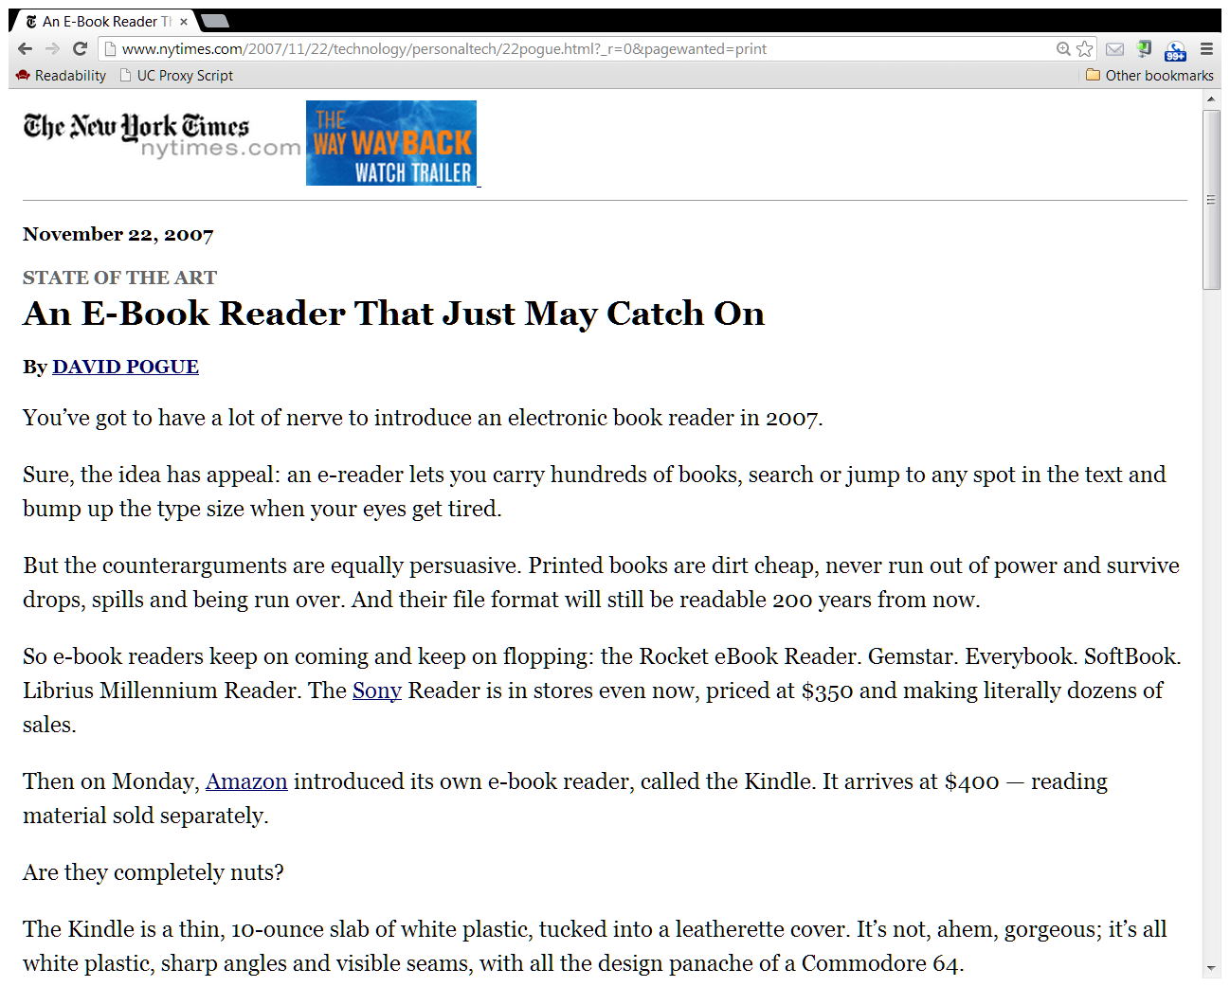
NYT, Nov 22, 2007
Notes:
Source: http://www.nytimes.com/2007/11/22/technology/personaltech/22pogue.html

Slide 55
Why Did Entry by Apple Lead to Higher Prices, Rather than Lower Prices?

Slide 56
What Happened?
Apple Orchestrated a Publisher Cartel
Publishers wanted to charge higher wholesale prices
  Amazon Kindle eBook reader started small but grew
  Amazon sold “best sellers” at or below the wholesale price; earned profit on Kindle and other books
  Publishers were concerned these low ebook prices would place downward pricing pressure on hardcover books
Apple wanted an ibookstore for eBooks its new iPad
that would not face a disadvantage from Amazon’s Kindle
  Apple did not want to be undersold by Amazon
  Apple earns a commission, so it does not care if prices are higher
Thus, there was “room for a deal!”
But how to offset Amazon’s buyer-side power?

Slide 57
The Publishers’ Dilemma
All the publishers needed to act in concert
  Answer: Apple could be the “hub” of a hub-and-spoke conspiracy
Publishers need to prevent Amazon from selling below the wholesale price
  Answer: Publishers could set retail prices instead of wholesale prices (i.e., “resale price maintenance” or “agency pricing”)
Publishers need to commit to prevent Amazon from charging a lower wholesale price
  Answer: Publishers could insert “Most Favored Nations” clause into Apple and Amazon contracts, which would prevent Amazon from undercutting Apple
Publishers benefit from simplified pricing to maintain stability
  Answer: Apple suggest pricing tiers

Slide 58
“Agency” Pricing Model Suggested by Apple
Wholesale Pricing Model
  Book publishers set wholesale prices and sell books to retailers
  Retailers (Amazon and bricks & mortar) unilaterally set retail prices
Agency Pricing Model
  Wholesalers do not sell books to retailers; Retailers instead act as agents in selling books directly to consumers
  Wholesalers set prices at which books are sold to consumers
  Retailers are paid fee for agent services
  Equivalent to wholesale pricing with “resale price maintenance” agreements
Retail MFN Provision
  Publisher contracts provide that it will not set lower retail price for Kindle than Apple
  The Clause: “If, for any particular New Release in hardcover format, the then-current Customer Price at any time is or becomes higher than a customer price offered by any other reseller (“Other Customer Price”), then Publisher shall designate a new, lower Customer Price to meet such lower Other Customer Price.”

Slide 59
What Exactly Did Apple Do to Further the Plan?
Eddy Cue as the “Cartel Ringmaster”
Apple VP Eddie Cue communicated with all Big Six publishers
  Apple told each publisher what other publishers were thinking.
  Evidence showed that the publishers also communicated among themselves
Apple orchestrated the design and move to the agency model
  Agency model allowed “the publishers to wrest control over pricing from Amazon.”
Apple orchestrated the design and move to the retail MFN (“most favored nations” provision)
  MFN prevented publishers from giving Amazon a better deal
For details, see DOJ Closing Argument Slides (posted on Canvas)

Slide 60
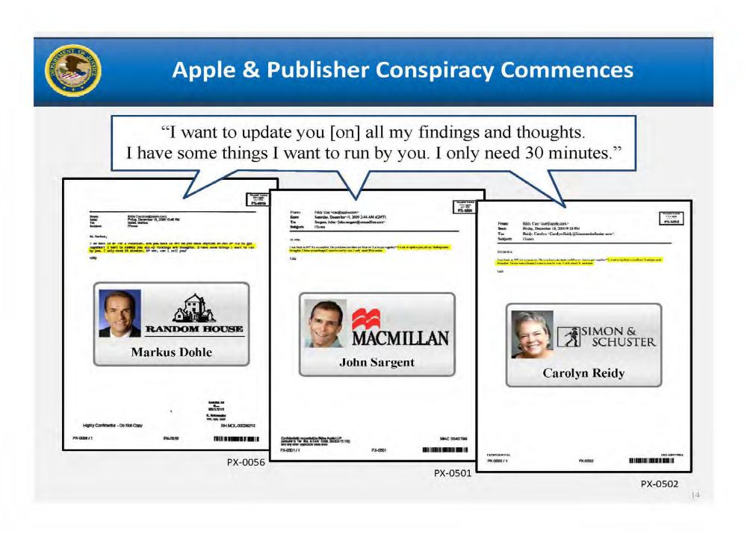

Slide 61
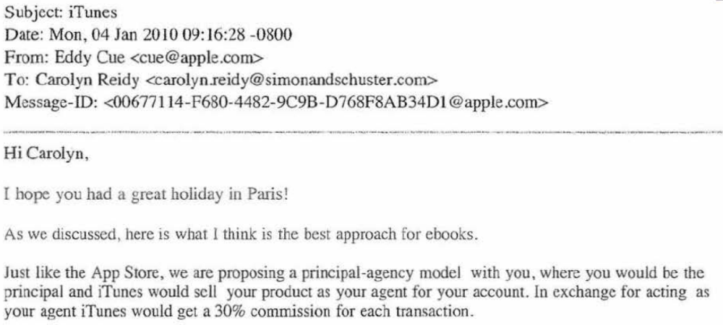
Cue Email to Reidy, Mon, Jan 4, 2010, PX-0021

Slide 62
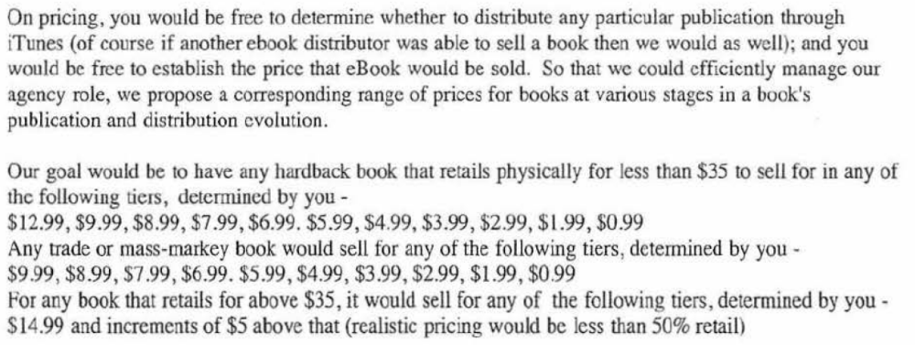
Cue Email to Reidy, Mon, Jan 4, 2010, PX-0021

Slide 63
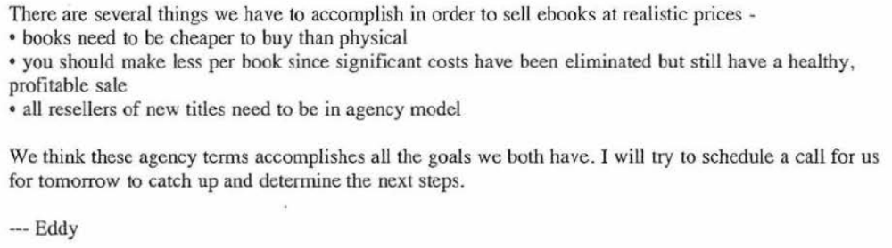
Cue Email to Reidy, Mon, Jan 4, 2010, PX-0021

Slide 64
Economic Analysis:
Retail MFNs Alter the Publishers’ Pricing Incentives
MFNs changes the negotiation dynamics in a fundamental way
Retail MFN prevents publishers from allowing Amazon to charge a lower price than Apple for ebooks
Reduces Amazon’s incentive to negotiate for a lower price, since cannot gain an advantage
Amazon cannot threaten to discount books of rival publishers since all publishers have agency model and Retail MFN
Bottom Line: Prices Increased

Slide 65
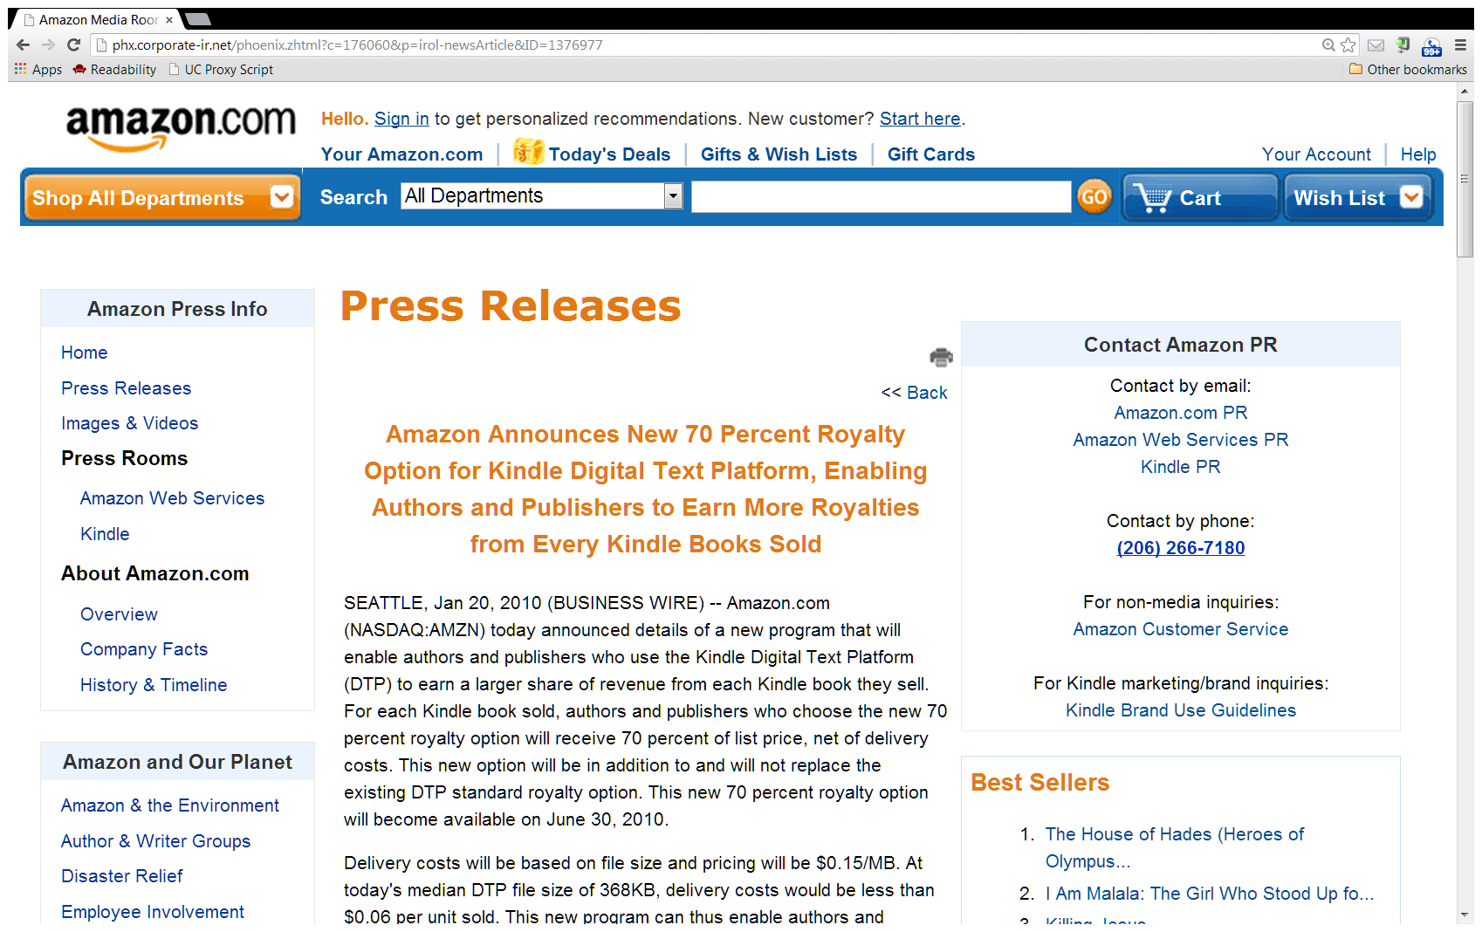
Amazon, Jan 20, 2010

Slide 66
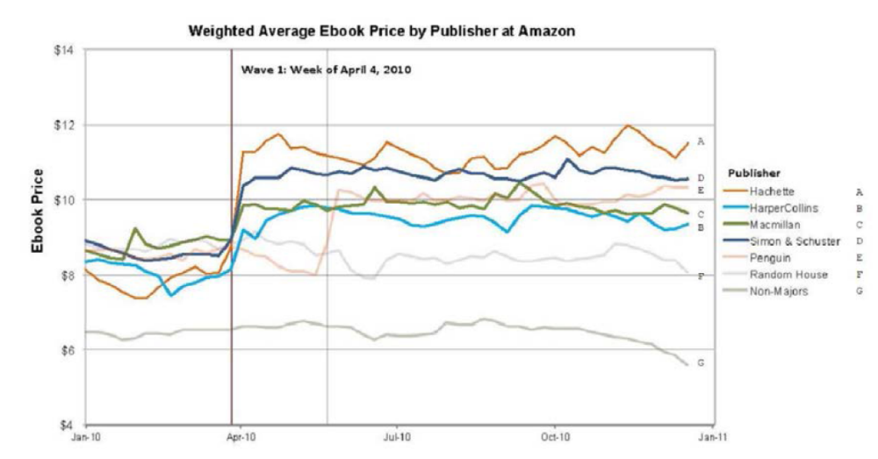

Slide 67
Legal Analysis

Slide 68
Outcome
Publishers concede agreement and accept consent decree
Apple goes to court.
DOJ wins. Apple’s agreements with publishers to adopt “retail MFNs” is per se illegal
2nd Cir agrees

Slide 69
2 Sidebar Issues in the Case
Why include Apple since there was a conceded publishers’ horizontal conspiracy
  Apple as the “cartel ringmaster,” the hub in the hub & spoke conspiracy
  Apple as the orchestrator of the agency model and the retail MFN
Was this a legitimate strategy to facilitate entry to compete with the dominant
e-retailer Amazon
  Yes – This goal animated one dissenting judge on 2nd Cir panel (but only one)
  No – This was not the only goal. Another goal -- and outcome -- was to raise prices for ebooks and hardcover books, thereby harming consumers
  Antitrust disfavors conspiracies that interfere with market forces (recall NSPE), even if framed as countervailing power “self-help”
    We will also see this later in Fashion Originators Guild Assoc (FOGA) case (Topic 17)

Slide 70
Hub-and-Spoke Conspiracies

Slide 71
Legal Analysis: Hub & Spoke Conspiracies
Apple “orchestrated” a horizontal conspiracy among the publishers
  Apple was the “Hub”
  Publishers were the “Spokes”
  The agreement among the publishers was the “Rim”– they communicated with each other as well as with and thru Apple
  In sum, the combo of Apple and the publishers formed the whole “Wheel”
  The Rim is what makes the conduct per se illegal
Other Hub & Spoke conspiracy cases with a Rim
  Interstate Circuit
  Toys R Us
Proving the Rim
  Explicit communication and agreement among the Spokes shown by direct evidence
  Communication and agreement among the Spokes indirectly occurs thru the Hub, allowing inference of horizontal agreement
    Mere knowledge of other vertical agreements likely not sufficient
    Knowledge plus agreement contingent on agreement by others plus parallel conduct (as in Interstate Cir)
    Of course, other actions contrary to independent self interest also helpful

Slide 72
Figure 3-2 (p.320):
Interstate Circuit – The “Hub and Spoke” Conspiracy
Distributor
Distributor
Distributor
Distributor
Interstate
(Exhibitor)
O’Donnell
Texas Consolidated
(Exhibitor)
Hoblitzelle
Distributor
Distributor
The government was trying to prove the “outer rim”… that the Distributors conspired.
Distributor
Distributor

Slide 73
Toys R Us (7th Cir. 2000): Exclusionary Group Boycott
Market Facts
  Club stores carry only the most popular toys and sell them at significant discounts
  Club stores becoming important competitors to TRU and other traditional retailers
Alleged anticompetitive conduct by FTC
  TRU orchestrates an Interstate Circuit-style hub-and-spoke conspiracy among leading toy manfacturers (Mattel, Kenner, etc.) to withhold certain toys or otherwise disadvantage club stores
Seventh Cir. Affirms FTC
Case fits Interstate Circuit
  “The sudden adoption of measures under which [toy manufacturers] decreased sales to the clubs ran against their independent economic self-interest.”
  “Abrupt shift from the past.”
  “ Each manufacturer was afraid to curb its sales to the warehouse clubs alone, because it was afraid its rivals would cheat and gain a special advantage in that popular new market niche.”
  “Direct evidence of communications that was missing in Interstate Circuit.”
  TRU communicated the message that “‘I’ll stop if they stop’ from manufacturer to manufacturer”
  Almost all the major toy mfgs participated in an essential boycott of the club stores

Slide 74
What If There is No Rim?
Some courts have found Rimless conspiracies
But others would treat as a series of independent vertical agreements, subject to the rule of reason
  “Without the rim of the wheel to enclose the spokes,’ a single,wheel conspiracy cannot exist but instead is a series of multiple conspiracies between the common defendant and each of the other defendants.” (US v. Swafford, (6th Cir. 2008)
  “For a hub and spoke conspiracy to function as a single unit, a rim must connect the spokes together, for otherwise the conspiracy is not one but many.” (US v. Bustamante, (7th Cir. 2007)

Slide 75
Application of No-Rim to Apple
Suppose hypothetically that there was no Rim in the eBooks case
  Suppose that Apple clearly negotiated agency model and MFN with each publisher unilaterally and sequentially
  Suppose that the publishers had not communicated among themselves and Apple did not act as a cartel messenger.
  So, Interstate Circuit standard would NOT be satisfied
But, a series of such vertical MFNs agreement can violate Section 1
  MFNs can lead to horizontal price increases without express collusion
Lack of horizontal conspiracy would be harder and more complicated for the plaintiff
  Potential inference that each individual MFN was in the publisher’s own independent self-interest
  An MFN by only one publisher might not lead to higher prices
Analyze in more detail with respect to Ohio v American Express (Topic 26)

Slide 76
Looking Directly Ahead to Topic 8 (Facilitating Practices)
Certain Unilateral or Coordinated Conduct Can Facilitate Successful Collusion (Tacit or Express Collusion)
  By facilitating reaching consensus
  By reducing incentives to cheat
    By speeding detection
    By increasing punishment ability or incentives
These conducts are called “Facilitating Practices.”
Note: Topic 8 material likely will take less than the full class. I will use the extra time to introduce merger law and practice (Topic 9). However you do not need to read ahead.

