Slide 1
Topic 20
Innovation and the Microsoft Case
Professor Steven Salop
Antitrust Econ & Law
Fall 2021

Slide 2
Introduction: Innovation and Antitrust
Innovation competition is a very important contributor to welfare, perhaps more important than price in many industries
  Lower costs/higher quality products faster
Economic framework for analyzing innovation competition
  Economics Idea #1: The prospect of gaining market (monopoly) power provides incentives for innovation
  Economics Idea #2: Maintaining competition among potential innovators is key to achieving rapid innovation
The Microsoft case was based on Idea #2
Erroneous economics claim
  Monopolists innovate more than do competitors, so they should be permitted to exclude rivals in order to maintain their innovation incentives
  This claim incorrectly conflates the prospect of gaining monopoly with the reduced incentives to innovate by a monopolist with a protected monopoly that cannot be effectively challenged
These ideas are very timely now in analyzing dominant digital platforms
  Google, Facebook, Amazon, Apple
Analogous to rejected claim in Polygram

Slide 3
Innovation and Its Benefits
Innovation can benefit consumers in several ways
  Innovative entry can reduce market power of incumbent firms (so-called “static” effects)
    Reduce price and increase output
    Diagram – Movement along the demand curve to lower price
  Innovation that leads to new or superior products can lead to lower “quality-adjusted” prices (so-called “dynamic” effects)
    Diagram - Shift demand curve up and to the right
See next slides for diagrams

Slide 4
Cost Reductions Can Lead to Lower Prices
A
P₁
P₂
B
C₁
C₂
Q₁
Q₂

Slide 5
Higher Quality → Higher Demand -- Higher Consumer Willingness to Pay
P1
D2
D1
Q1

Slide 6
Microsoft (D.C. Cir. 2001)

Slide 7
Microsoft Chronology (pp. 669-71)
20+ Years of Litigation
  1990 – FTC Investigation Opened
  1993 – Transfer to DOJ when FTC splits 2-2 (1 recusal)
  1994 – DOJ-Microsoft “per processor” licensing Consent Decree re Windows 95
  1998 – U.S. and 20 States sue Microsoft over IE/Windows 98 and range of conduct
  2000 – USDCT finds against Microsoft on most claims & orders it broken up
  2001 – D.C. Circuit Decision – affirms most liability; reverses break-up remedy
  2001-02 – Settlement of 1998 case when Administration changes (Clinton to Bush II)
  1998-2013 – more than 200 private cases; prosecutions in EU, Japan, Korea
Total cost to Microsoft
      ~ $9 billion in fines and damages
      Substantial legal costs + loss of focus by top management
      Loss of stock mt value when judgment announced ~$80 billion
      Next-generation: Google dominates search; Apple and Google dominate mobile operating systems; server software moves to open-source (Linux); Amazon innovates and leads shared-cloud computing
      But, Microsoft still maintains dominance in desktop OS and Office

Slide 8
Clashing Antitrust Narratives of Innovation
Microsoft as innovator
Microsoft created the PC business and has been a major OS and applications innovator
Faces constant threat of being overtaken by next new technology
Disgruntled, weak rivals “captured” courts, not market
Antitrust law is outdated
Enforcers and courts lack understanding of tech markets
Legal process too slow for markets on “Internet Time”
Rivals as innovators
Microsoft as lazy monopolist
Tried to buy Netscape, but was rebuffed
Having failed at collusion, turned to exclusion
When it fell behind the competition, it used its market power to stifle competition

Slide 9
Quick Overview of DOJ’s Microsoft Case.
Basics
  Anticompetitive conduct to exclude the emergence of independent
  multiplatform browsers (especially Netscape), which were enabled with Java
  Netscape & Java had APIs, so apps could write to them and not write specifically to Windows
Factual allegations
  Restrictive contracts prevented OEMs from removing IE or installing rival browsers
  Microsoft then made IE impossible to remove by OEMs
    Integrated IE code with Windows
    Did not include IE in the Add/Remove Programs utility
  Prohibiting OEMs from deleting certain items from desktop and Start menu
  (alleging making it harder for consumers to choose Netscape Navigator)
  Priced IE at zero (although it cost $100 million a year to develop and maintain it) (predatory pricing)
Claims
  Monopolization of the PC operating system market through unlawful maintenance
  (Topic 20; today)
  Predatory pricing as attempted monopolization of the browser market (Topic 19, but not discussed)
  Illegal tying of Internet Explorer to the Windows operating system (Topic 22)
  Exclusive dealing with PC OEMs as to browser software (Topic 23)
Desired Relief: Breakup of Microsoft into a separate operating system
and applications companies
Result: Could reduce BTE to OS market;
add competition
No claim that monopoly achieved illegitimately
Ultimately settled
with behavioral remedy

Slide 10
Bill Gates “Internet Tidal Wave” Memo (May 1995)
In the next 20 years the improvement in computer power will be outpaced by the exponential improvements in communications networks. The combination of these elements will have a fundamental impact on work, learning and play. Great software products will be crucial to delivering the benefits of these advances. Both the variety and volume of the software will increase.
The Internet is at the forefront of all of this and developments on the Internet over the next several years will set the course of our industry for a long time to come. Perhaps you have already seen memos from me or others here about the importance of the Internet. I have gone through several stages of increasing my views of its importance. Now I assign the Internet the highest level of importance. In this memo I want to make clear that our focus on the Internet is crucial to every part of our business. The Internet is the most important single development to come along since the IBM PC was introduced in 1981.
Most important is that the Internet has bootstrapped itself as a place to publish content. It has enough users that it is benefiting from the positive feedback loop of the more users it gets, the more content it gets, and the more content it gets, the more users it gets.
A new competitor "born" on the Internet is Netscape. Their browser is dominant, with 70% usage share, allowing them to determine which network extensions will catch on. They are pursuing a multi-platform strategy where they move the key API into the client to commoditize the underlying operating system. They have attracted a number of public network operators to use their platform to offer information and directory services. We have to match and beat their offerings including working with MCI, newspapers, and other who are considering their products.
One scary possibility being discussed by Internet fans is whether they should get together and create something far less expensive than a PC which is powerful enough for Web browsing.
The next few years are going to be very exciting as we tackle these challenges are opportunities. The Internet is a tidal wave. It changes the rules. It is an incredible opportunity as well as incredible challenge I am looking forward to your input on how we can improve our strategy to continue our track record of incredible success.
https://www.wired.com/2010/05/0526bill-gates-internet-memo/
Network
effects

Slide 11
Economic Background Summary:
“Network Effects” Can Lead to Durable Monopoly Power
“Direct” Network Effects: Consumer value of product increases when more consumers use the product
  Communication systems as classic example (telephones; social media)
  Value rises exponentially when there are more users
  Also true for many products desired by “conformist” consumers
“Indirect” Network Effects for Two-Sided Network Markets
  Firm earns revenues from customer on two-sides of a network market
  Example 1: Newspaper sells ads to advertisers, who value more readers who buy subscriptions;
  and vice versa
  Example 2: Credit card accepted by more Merchants also attracts more Cardholders, and vice versa
  Example 3: Operating system with more Applications attracts more Users; And vice versa – More Applications will be written for OS with more Users
“Applications Barriers to Entry” from Network Effects
  Where network effects are large, markets tend to “tip” to dominance or monopoly
  If a firm has a monopoly in a network market, barriers to entry are high because rivals have
  no installed base of users to create value, even if entrant’s product is better
  Example: Monopolist’s OS might be inherently worse, but maintains more apps and more users because of network effects barrier to entry

Slide 12
Direct Network Effects
Examples: Telephone system or social media
Value of membership rises when others join
And the largest network has advantages over small networks, even if the large network has somewhat lower quality
1
6
In fact, value rises “exponentially”
Metcalf’s Law: Value rises by the “square” of the number of members (Value = ~ N²)
A
B
A
B
3
A
B
C
D
C

Slide 13
Indirect Network Effects and Two-Sided Platforms
“Platforms” facilitate interaction or transactions between participants on “two-sides”
  Credit card networks (Visa) – card users on one side; merchants on the other side
  Google – searchers on one side; advertisers on the other
  Amazon marketplace – vendors on one side; consumers on the other
  Microsoft/Apple/Android OS -- users on the one side; application developers on the other
Network effects: more participants on one side will increase demand for the platform by participants on the other side
These network effects can raise “network barriers to entry”
This applies to the indirect network effects between “applications” and “users” for different “operating system” platforms
Barriers occur when Users tend to use only one platform (“single homing”) and platforms are not “interoperable”

Slide 14

Applications are Specific to Operating System: Unique APIs (Circa 1998)
Application
Software
Symantec
for Windows
Symantec
for IBM
OS/2
Symantec
for
Macintosh
Symantec
for Unix
(Linux)
Operating
System
Windows
IBM OS/2
Macintosh
Unix
This incompatibility can lead to a chicken-and-egg
problem in a market with network effects

Slide 15
The Applications Barrier To Entry
(From “Indirect Network Effects”)
Application Developers
will prefer to write programs for the OS with the most Users
Web Applications
Windows
Operating System
Rival
Operating System
Consumers prefer the OS with the largest number of Application
Users

Slide 16
Overcoming the Application BTE with “Middleware”
Java and Netscape “Middleware”
  Netscape APIs
  Java Programming Environment/APIs
  Netscape as Distributor of Java “Virtual Machine” (the translator)
Middleware acts like a “universal language”
  Java slogan: “Write once, Run everywhere”
Java and Netscape thus represent a “nascent” competitive threat to Microsoft’s dominance in OS

Slide 17
Application Written In Java Is Cross-platform Compatible
Application
Written in JAVA
Application
Software
Netscape Browser
included Java JVM
Will Run On Any Platform
JAVA
Virtual
Machine
(JVM)
JVM
JVM
JVM
JVM
Operating
System
Windows
IBM OS/2
Macintosh
Unix

Slide 18
Analysis of the D.C. Circuit Opinion

Slide 19
Overview: Three Issues on Appeal
Monopoly Power (pp. 536-43)
  Hotly contested by experts, but ultimately an easy issue
  Court affirms “in its entirety”
Exclusionary Conduct & Anticompetitive Effects (pp. 543-51)
  Windows monopoly maintenance (using IE as a tool)
    Various conduct: IE exclusive contracts; contractual tying of Windows/IE; technological tying; threats
    But claim re attempt to monopolize “browser market” fails
  Legal standard: DC Cir applied a Section 2 rule of reason
    Probable effect + lack of cognizable justifications = Section 2 violated
    ROR standard was big surprise to both sides!
Remedies - Structural vs. Behavioral (pp. 669-76)
  District Ct: Break up Microsoft; DCCA reversed (District Ct held no evidentiary hearing)
  Ultimate Settlement: Narrowly targeted conduct prohibitions

Slide 20
Proving Microsoft’s Market Power: Figure 4-7:
Microsoft
No market power in any relevant market (“behavioral” approach)
  Leap-frog competition
  Innovation
  Intense competition
No significant barriers to entry
  Sunk costs
  Switching costs
  Network effects
  Applications
Not possible to define a relevant market and calculate market shares
  Middleware
  Servers
  Other Oss
Profits and margins are normal
for software
Conduct evidencing vibrant competition
  Investment in R&D
  Low price for Windows
Circumstantial Evidence
Governments
Persistent high share of defined relevant market (double inference)
Barriers to entry
  Sunk costs
  Scale economics
  Switching costs
  Network effects
  Applications
Conduct constituting the exercise of market power (single inference) and actual anticompetitive effects
  Exclusionary
  Collusive
    Prices
    Profit margins
    Equity Value
Court of Appeals
Persistent high share in properly defined relevant market
Applications Barriers to Entry
Conduct constituting the exercise of market power (single inference) and actual anticompetitive effects
Direct Evidence
Windows priced below the short-run profit-max level, implying lack of monop power
p. 543

Slide 21
Anticompetitive Conduct and Effect: Summary
Governments
Conduct maintained applications barrier to entry
  Contractual provisions
  Technical integration
  Threats
Conduct prevented Netscape from replacing IE, which maintained Apps BTE (Java distributed as part of Netscape)
Microsoft maintained monopoly market share
Microsoft
Actions were not predatory or exclusionary
  Improving its own products
  Efficiencies in integrating Windows and IE
  Zero price for IE on development path for integrating Windows and IE
  OEM restrictions justified in order to “preserve the quality and speed of the start-up process”
  Netscape was not cut off from essential channels of distribution and in fact continue to grow
    Could and did successfully distribute Netscape through web downloads
Did not price at short-run monopoly levels
  Government did show that Microsoft’s actions were not profit-maximizing apart from any predatory motives
  Could have priced Windows much higher
  (Also entered monopoly power issue)

Slide 22
Anticompetitive Conduct
A “monopoly broth”
Government alleged a panoply of anticompetitive conduct under Section 1 and Section 2
  Windows licensing restrictions
  Technological integration of IE and Windows
  Contracts with OEMs to install IE exclusively (exclusive dealing under Section 1)
  Contractual and technological tying of Windows and IE
  (tying under Section 1
  Threats
Topic 25
Topic 42

Slide 23
Anticompetitive Conduct: Licensing Restrictions (pp. 544-545)
Goal: Reduce middleware share, and
thereby maintain Apps BTE
Restrictions
  Prohibit removal of icons to deter OEM from installing a second browser
  Prohibit interruption of boot sequence
Justifications
  Broad IP defense
  Does not totally block Netscape distribution
Obvious Query: Why couldn’t users just download another browser?
Answer: Back in the day, that was not so easy. The internet was painfully slow and sketchy; downloads often failed; and users were very nervous amateurs
Answer: IP defense overly broad. IP does not overrule antitrust
Answer: Blocked the “most cost-effective” distribution means (i.e., RRC)

Slide 24
Threats
Microsoft threatened other firms not to help Java
It also made threats not to compete with Microsoft’s Windows products in various ways
One famous example from the trial:
An Apple executive charged that Microsoft proposed “knifing” Apple’s multimedia products in a meeting between the two companies.
[...]
Tevanian told the court: “Mr. Hoddie said, ‘Do you want us to knife the baby?,’” referring to QuickTime. “And Mr. Phillips said, ‘Yes we’re talking about knifing the baby.’”
https://www.sfgate.com/politics/article/Microsoft-Asked-Apple-to-Knife-the-Baby-Court-2980345.php

Slide 25
Anticompetitive Conduct: Technological Integration of
IE and Windows (pp. 548-551)
Restrictions
  No choice menu like today
  IE browser excluded from Add/Remove
  IE and OS code was “commingled” so IE code could not be removed
  Over-ride user’s choice of browser in some circumstances
DC Cir analysis
  “Deference” to design changes (including incompatibility) does NOT mean that all changes are per se legal (pp.549-50)
  Design reduced quality of user experience with rival browsers
  Inability to remove IE deterred OEM from installing a second browser
DC Cir on Microsoft justifications
  No justification for commingling code or Add/Remove restrictions
  Accepted that it was necessary to overriding user choice in some circumstances
See language on next slide
Microsoft major
litigation error!
Government did not rebut this
narrower claim

Slide 26
D.C. Circuit: Section 2 Structured Rule of Reason Legal Standard
(p. 544)
From a century of case law on monopolization under s 2, however, several principles do emerge.
First, to be condemned as exclusionary, a monopolist's act must have an "anticompetitive effect." That is, it must harm the competitive process and thereby harm consumers. In contrast, harm to one or more competitors will not suffice. "The [Sherman Act] directs itself not against conduct which is competitive, even severely so, but against conduct which unfairly tends to destroy competition itself."
Second, the plaintiff, on whom the burden of proof of course rests must demonstrate that the monopolist's conduct indeed has the requisite anticompetitive effect. In a case brought by a private plaintiff, the plaintiff must show that its injury is "of 'the type that the statute was intended to forestall,’ “ … the Government … demonstrate that the monopolist's conduct harmed competition, not just a competitor.
Third, if a plaintiff successfully establishes a prima facie case under s 2 by demonstrating anticompetitive effect, then the monopolist may proffer a "procompetitive justification" for its conduct. If the monopolist asserts a procompetitive justification -- a nonpretextual claim that its conduct is indeed a form of competition on the merits because it involves, for example, greater efficiency or enhanced consumer appeal--then the burden shifts back to the plaintiff to rebut that claim.
Fourth, if the monopolist's procompetitive justification stands unrebutted, then the plaintiff must demonstrate that the anticompetitive harm of the conduct outweighs the procompetitive benefit. In cases arising under s 1 of the Sherman Act, the courts routinely apply a similar balancing approach under the rubric of the "rule of reason."
Finally, in considering whether the monopolist's conduct on balance harms competition and is therefore condemned as exclusionary for purposes of s 2, our focus is upon the effect of that conduct, not upon the intent behind it. Evidence of the intent behind the conduct of a monopolist is relevant only to the extent it helps us understand the likely effect of the monopolist's conduct.

Slide 27
Alternative Section 2 Standards
Profit-Sacrifice & Sole Purpose Tests commonly are required in addition to consumer welfare harm, not instead of.
Microsoft
  More Interventionist
  No fault (i.e., no anticompetitive conduct element)
    Per se illegal to achieve/maintain monopoly power
    Duty to cooperate with rivals
  No fault, but with excuses [burden of proof TBD]
    SSFI (business acumen; better product; lower costs)
    Natural monopoly
    Historical accident
    Burden on defendant to show excuses (analogous to “quick-look” standard
    Grinnell may place burden on plaintiff
  Consumer welfare harm (with variants)
    Net consumer harm under basic Rule of Reason
    “Section 2 unreasonableness” standard
      “Unreasonably exclusionary” conduct
      “Unduly coercive” conduct
      “Unnecessarily restrictive” conduct
      "primary purpose and effect"
  “Disproportionate” harm variant (Hovenkamp):
  a slightly more permissive variant, whereby consumer harm must “significantly” exceed benefits (i.e., near-ties awarded to the defendant) (small “thumb on the scale”)
  Less Interventionist
  Profit-Sacrifice (sometimes called “predation” standard)*
    Conduct “unprofitable ‘but-for’ impact on monopoly power”
    Conduct would make “no economic sense” absent impact on monopoly power
    Standard also probably would require proof of consumer harm
    Some commentators would add that plaintiff must show that it was equally efficient (as an additional thumb)
  Sole purpose to exclude *
    “No legitimate business reasons” for conduct
    “maneuvers not honestly industrial”
    Also requires proof that conduct caused harm to consumers, but that harm might be “inferred” from harm to competitors
  Per se legality [Eliminate Section 2]
  * Essentially anticompetitive purpose (“intent”) standards re “willful” conduct; Sometimes interpreted as “prudential safe harbors” to avoid over-deterrence.

Slide 28
Microsoft Rule of Reason is a Two-Edged Sword for Plaintiffs:
Plaintiff must “Demonstrate,” but Defendant may merely “Assert”
Pro-Plaintiff
  Easier to win under ROR than Profit-Sacrifice/No Econ Sense/Sole Purpose standards
Pro-Defendant
  Language appears to place a low rebuttal burden on defendant:
  “if a plaintiff successfully establishes a prima facie case under section 2 by
  demonstrating anticompetitive effect, then the monopolist may
  proffer a "procompetitive justification" for its conduct. If the monopolist
  asserts a procompetitive justification -- a nonpretextual claim that its conduct is indeed a form of competition on the merits because it involves, for example, greater efficiency or enhanced consumer appeal--then the burden shifts back to the plaintiff to rebut that claim.”
Subsequent courts have varied in whether to require substantial evidence by defendant versus mere assertion.

Slide 29
Factual Analysis under Section 2 Rule of Reason: Balancing Issues
Microsoft failed to rebut findings of fact regarding competitive harm
Microsoft failed to even offer efficiency justifications for particular alleged anticompetitive conduct
Under rule of reason approach, the showing of competitive harm and failure to offer procompetitive justification implies liability.
With respect to Microsoft restrictions on alteration of boot sequence, Microsoft offered a justification and Government failed to show that harms outweighed benefits, so no liability (pp. 547-48)
Court did balance for the one issue where balancing was required
Why so little balancing? Both Governments and Microsoft were litigation under the assumption that the relevant legal standard was “profit sacrifice”/“no economic sense” -- not ROR
Thus, no need to balance
Thus, no need to balance
See discussion of preventing substitute interface (pp. 547-48)

Slide 30
Microsoft’s Broad Innovation Defense Rejected (p. 549)
“As a general rule, courts are properly very skeptical about claims that competition has been harmed by a dominant firm’s product design changes. In a competitive market, firms routinely innovate in the hope of appealing to consumers, sometimes in the process making their products incompatible with those of rivals; the imposition of liability when a monopolist does the same thing will inevitably deter a certain amount of innovation. This is all the more true in a market, such as this one, in which the product itself is rapidly changing.”
“Judicial deference to product innovation, however, does not mean that a monopolist’s product design decisions are per se lawful.”

Slide 31
Microsoft No-Causation Analysis Rejected (pp. 551-52)
Microsoft claim: Government did not show that Netscape and Java would have succeeded,
absent the conduct
D.C. Circuit response
  Microsoft conduct is “reasonably capable of contributing significantly to a defendant’s continued monopoly power”
  Requiring reconstruction of hypothetical marketplace absent the conduct “would only encourage monopolist to take more and earlier anticompetitive action.”
  “It would be inimical to the purpose of the Sherman Act to allow monopolists free reign to squash nascent unproven competitors.”
  One very large “BUT”
  Causation more relevant to “appropriate remedy issue” (i.e., structural or conduct remedy) (p. 552)

Slide 32
Remedy Analysis

Slide 33
Section 2 Remedies, In General
Three basic remedial goals
  Terminate the anticompetitive conduct
  Deprive monopolist of the benefits of its anticompetitive monopoly
  Prevent recurrence (re-establish conditions for competition)
“Depriving the benefits” has 2 aspects
  Monetary damages for past conduct
  Re-establishing competition
Type of non-monetary remedies
  Structural
    Divestitures or licensing of critical assets
    Dis-integration of integrated monopolist)
  Behavioral
    Enjoining anticompetitive conduct
    Conduct restrictions (for fencing in; jump-starting competition
Structural ≈ Surgery
Behavioral ≈ Drug Therapy

Slide 34
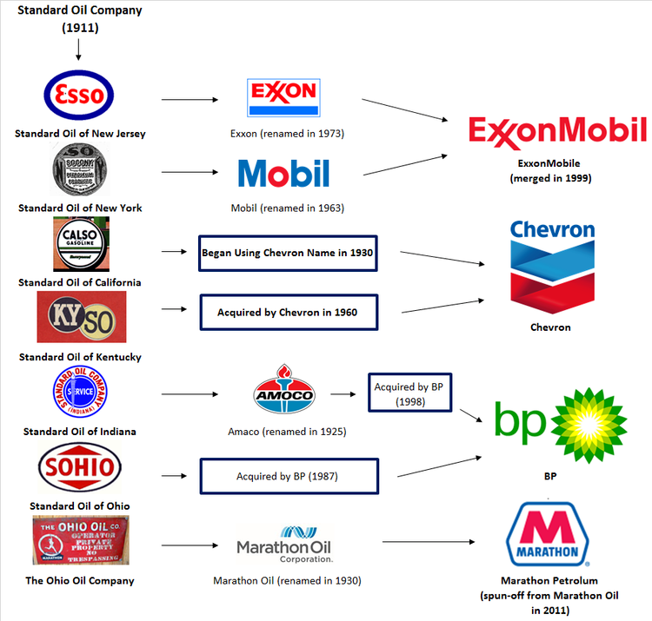
Standard Oil Dis-Integration & Re-Integration (Up Until 2011)*
*Courtesy: Prof Gavil

Slide 35
Causation Issue Affected Court on Microsoft Remedy (pp. 551-52)
“Microsoft’s concerns over causation have more purchase in connection with the appropriate remedy issue, i.e., whether the court should impose a structural remedy or merely enjoin the offensive conduct at issue.
As we point out later in this opinion, divestiture is a remedy that is imposed only with great caution, in part because its long-term efficacy is rarely certain.
Absent some measure of confidence that there has been an actual loss to competition that needs to be restored, wisdom counsels against adopting radical structural relief.”
Snatching DOJ defeat
from the jaws of victory?

Slide 36
Microsoft Remedy Issues
DOJ Proposal and Rationale:
  “Vertical” Breakup: Split Microsoft into separate OS and Apps companies
  Independent Apps company benefiting from network effects would work to facilitate OS entry (no 2-level entry needed)
D.C. Cir: No evidentiary basis for structural remedy
  District Ct did not hold hearing
  DC Cir remanded on remedy
Case later settled by consent decree after remand
  Windows/IE integration permitted as long icon could be removed
  Rest was conduct remedies
  Licensing to facilitate interoperability
  Proving violation of consent decree would require a rule of reason hearing
“Slice & Dice” remedy rejected by DOJ (i.e., vertical split plus license Windows code to 3 licensees)
Judge did not want to bother with a hearing until feedback from DC Cir on liability
Salop’s snarky comment
This is a “catch & release” remedy

Slide 37
Structural Remedy Relied on Mutual Entry “Sponsors” or “Supporters”
Divested Apps Co and OS Co analogous to Viadyne & Fabtech Diagram on Potential Entry
Apps Co
Apps
OS Co
AppsCo or
Sponsored
Entrant
OS
Consumers

Slide 38
Ultimate Impact of Microsoft Remedy
Microsoft was unable to use its monopoly power and exclusionary conduct to monopolize the “next generation,” as foreseen by the Bill Gates’ “Internet Tidal Wave” memo
  Google was able to enter and now dominates search, not Microsoft
  Microsoft failed to dominate mobile OS; leaders are Android and iOS
  Windows overall OS market share is less than 40%; Android is slightly larger
  Microsoft has failed to dominate cloud computing; leader is Amazon; Microsoft also competes with Oracle, Google and IBM
One possible cause is that the case distracted top management for several years
But Microsoft still dominates the desktop OS market
  Windows powers more than 75% of desktop computers worldwide
  2019 Windows revenue = $13 billion; likely profits ~ $10 billion

Slide 39
Incompatible Product Redesign Cases:
Further Analysis

Slide 40
Alternative Section 2 Standards Could Apply
Profit-Sacrifice & Sole Purpose Tests commonly are required in addition to consumer welfare harm, not instead of.
  More Interventionist
  No fault (i.e., no anticompetitive conduct element)
    Per se illegal to achieve/maintain monopoly power
    Duty to cooperate with rivals
  No fault, but with excuses [burden of proof TBD]
    SSFI (business acumen; better product; lower costs)
    Natural monopoly
    Historical accident
    Burden on defendant to show excuses (analogous to “quick-look” standard
    Grinnell may place burden on plaintiff
  Consumer welfare harm (with variants)
    Net consumer harm under basic Rule of Reason
    “Section 2 unreasonableness” standard
      “Unreasonably exclusionary” conduct
      “Unduly coercive” conduct
      “Unnecessarily restrictive” conduct
      "primary purpose and effect"
    “Disproportionate” harm variant (Hovenkamp): a slightly more permissive variant, whereby consumer harm must “significantly” exceed benefits (i.e., near-ties awarded to the defendant) (small “thumb on the scale”)
  Less Interventionist
  Profit-Sacrifice (sometimes called “predation” standard)*
    Conduct “unprofitable ‘but-for’ impact on monopoly power”
    Conduct would make “no economic sense” absent impact on monopoly power
    Standard also probably would require proof of consumer harm
    Some commentators would add that plaintiff must show that it was equally efficient (as an additional thumb)
  Sole purpose to exclude *
    “No legitimate business reasons” for conduct
    “maneuvers not honestly industrial”
    Also requires proof that conduct caused harm to consumers, but that harm might be “inferred” from harm to competitors
  Per se legality [Eliminate Section 2]
  * Essentially anticompetitive purpose (“intent”) standards re “willful” conduct; Sometimes interpreted as “prudential safe harbors” to avoid over-deterrence.

Slide 41
Comparing the Alternative Legal Standards:
Incompatible Product Redesign
Consider this hypothetical
  Dominant firm creates a new, incompatible product
  New product delivers $10 extra quality value to consumers
  New product costs $8 (or $15) more to produce than old product
  Because new product is incompatible with rivals’ products, rivals exit and
  dominant firm is able to raise price by $30, not just $10.
Would (or should) this redesign violate Section 2
  Sole purpose to exclude standard: Legal. New product is superior to old product.
  Profit-sacrifice/NES standard
    Legal if extra cost is $8 – new product makes sense even if price could only be raised by $10 extra value
    (i.e., assuming no incremental market power)
    Illegal if extra cost is $15 – introducing new product at an extra cost of $15 makes no economic sense if price can only rise by $10
    (i.e., assuming no incremental market power)
  Section 2 consumer welfare balancing standard
    Illegal. New product delivers $10 extra value, but price rise is $30, so consumers harmed
Judicial outcomes have varied!

Slide 42
Notable Exclusionary Product Redesign Cases
No consensus among courts!
XYZ v. IBM (1980s cases)
  IBM created a patented proprietary interface to maintain monopoly in peripheral equipment that connected to its monopoly “mainframe” computer
  Courts very permissive towards IBM contract
    Permit because incompatibility involved a new improved product
    Or, belief that analyzing design competition was beyond the capability of courts
CR Bard v. M3 (Fed. Cir. 1998)
  Affirmed jury verdict that incompatibility was predatory because incompatible product was not superior and appeared solely for the purpose of excluding rival
Allied Orthopedic v. Tyco (9th Cir. 2010)
  Virtual per se legality for product redesign
New York v. Actavis (2d Cir. 2015)
  “Product-hopping:” Actavis created a new patented product formulation with slight change, when its old patent expired. It also removed the old product from FDA Orange Book listing (of offered products) in order to prevent generic Rx competition using the old product formulation
  Court concluded that removing old product from Orange Book likely anticompetitive

Slide 43
Current Tech/Innovation Antitrust Cases

Slide 44
“Open Early, Close Late” Exclusionary Access
Facebook
  Provided API access to apps; but then remove access when FB enters that space
  This allegation dismissed by FB court on MTD as contrary to Aspen.
  Old cutoffs were not actionable since FTC must focus on future
  Current refusals to deal are not result of change in policy,
  so Aspen does not apply
Google Android
  Open source Android has been allowed to wither on the vine
  Most APIs now contained in trademarked Android that comes with restrictions
Google Ad Tech
  Provided rival ad exchanges/servers access to Google infrastructure, but then closed
Judge ignored
reputation and
deterrence effects

Slide 45
Novell v. Microsoft (10th Cir. 2013) (Gorsuch, J.)
Court frames profit-sacrifice in terms of “war of attrition” version of predatory pricing
  “Much akin predatory pricing doctrine, the animating concern here is that a dominant firm may be able to forgo short-term profits longer than smaller rivals, and it may have an incentive to take on those losses to drive rivals from the market or to discipline them for having the audacity to try competition on the merits rather than abide as price-takers under the monopolist’s umbrella.”
Court equates “profit-sacrifice” and “sole purpose to exclude” tests
  “The point of the profit sacrifice test is to isolate conduct that has no possible efficiency justification.”
Court appears to reject liability if “simultaneous recoupment” in a related line of business
  “Novell’s theory … rests on the view that Microsoft’s withdrawal of NSEs allowed it to win significant profits in the sale of office suite applications — and to do so immediately. …. Microsoft is an integrated firm with the goal of maximizing overall profits. And viewed overall, there’s no evidence that Microsoft took any course other than seeking to maximize the company’s net profits in the short- as well as long-term.”
  An email indicates a “desire to keep NSEs from rivals ‘until we have a way to do a high level of integration [that] will be harder for the likes of Notes, WordPerfect to achieve, and which will give Office a real advantage.’ This may suggest a hard-nosed intent to undo rivals in the applications field, to assure Microsoft a leg up, but it doesn’t suggest Microsoft intended to forgo profits. More nearly, it suggests just the opposite — a wish to increase the firm’s immediate profits —and in this way it tends to show that Microsoft’s conduct was hardly irrational but for its exclusionary tendencies.”

Slide 46
Google Search: Maintenance of Search Advertising Monopoly
Monopolization of Search Advertising
Alleged anticompetitive conduct: Creation of a Monopoly Sales Agency for Search Ads
  Profit-Sharing Payments to various entities to make Google Apps (that are used for search) the defaults (or exclusives)
  (e.g., Apple Safari, Mozilla Firefox, Wireless carriers)
  Android license restrictions on device makers to
  preload Google Apps (Chrome; Search; Maps)*
Monopoly power
  High consumer search and search advertising market shares
  Network barriers to entry
Complaint focuses only on search ads, not contextual display ads found in newspapers, etc.
Complaint has little to say on whether Google search is a “two-sided transaction platform” for which the awkward Amex approach might apply
  * This also was part of the EU’s 2018 case against Google that led to a €4.3 billion fine
  https://www.theverge.com/2018/7/18/17580694/google-android-eu-fine-antitrust

Slide 47
Maintaining Google Search Monopoly With Exclusives
Android Licensees required to give prominence to Google search apps
Google makes profit-sharing payments to use Google search paid to Safari, Mozilla, Verizon, etc.
Google Deals
Google
websites
Android
Licensees
Browsers/
OEMs
Apple
Default
Search
Engine
& Browser
DOJ Complaint : In 2019, almost 50% of Google search traffic originated on Apple devices. Google/Apple agreements cover ~36% of US search queries.
Google
Search
Rivals
Search
Advertisements
Advertisers

Slide 48
“Open Early, Close Late” Exclusionary Access
Facebook
  Provided API access to apps; but then remove access when FB enters that space
  This allegation dismissed by FB court on MTD as contrary to Aspen.
  Old cutoffs were not actionable since FTC must focus on future
  Current refusals to deal are not result of change in policy,
  so Aspen does not apply
Google Android
  Open source Android has been allowed to wither on the vine
  Most APIs now contained in trademarked Android that comes with restrictions
Google Ad Tech
  Provided rival ad exchanges/servers access to Google infrastructure, but then closed
Judge ignored
reputation and
deterrence effects

Slide 49
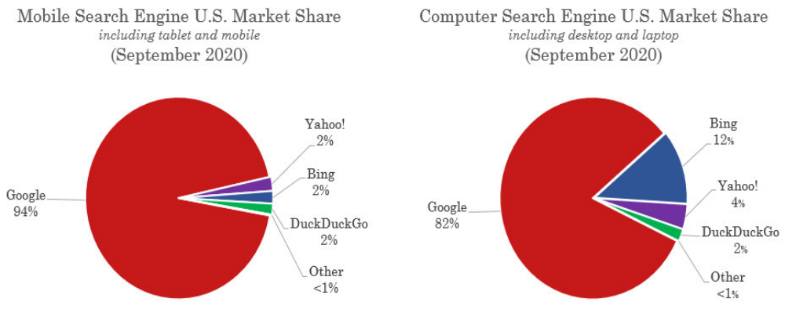
Google Search Engine Market Share

Slide 50
Analysis of Default Status for Google Search
Android OEM licensees required to favor Google search and other apps
  Question: Is this self-preferencing an acceptable way for Google to obtain payment for its Android OS
Android shares revenue with Android licensees and wireless phone companies to obtain favorable treatment of Google search apps
  Question: Are these payments anticompetitive?
Do “defaults” even matter when it is so easy to download other apps or change default settings? When “competition is only a click away?
Yes, they matter. If unhappy consumers were so likely to switch -- why did Google pay so much to Apple ($8-12 billion; ~ 33% of Alphabet profits, as calculated by the WSJ) for default status?

Slide 51
Remedy Issue: Sufficiency of Enjoining Google Payments to Apple and Others for Default Status of Google Search
The EU (Android case) forced Google to list 3 other search engines as possible defaults in a choice menu. However, these other engines are chosen by an auction in which Google receives the proceeds.
Big Fact/Policy Question
If Google were prohibited from bidding for defaults, what would be the market outcome?
Several possibilities:
Apple enters with its own search engine. (Apple accounts for a huge fraction of searches.)
Bing buys default status -- and quickly improves because the huge increase in its scale
Huge windfall gain for Google. Google is still chosen, but now does not need to pay.
Additional Injunction is Needed
Google also must be prohibited from sharing search revenue, even if no default status required:
If Google pays a share of its search revenue, Apple and others will voluntarily favor Google search.
Google has the incentive to pay a substantial share of monopoly profits to deter entry

Slide 52
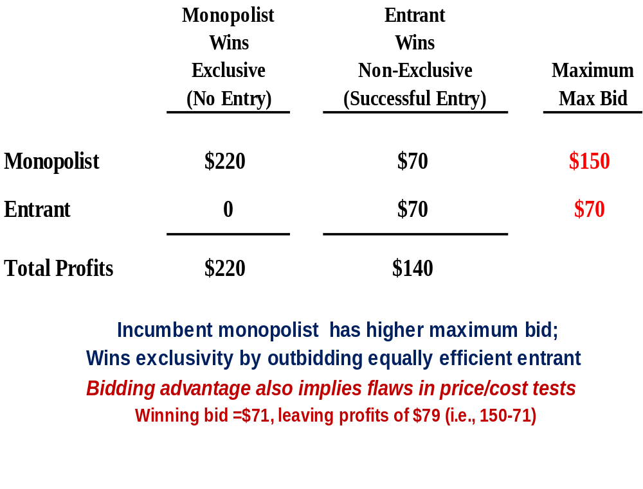
Why a Monopolist Bids More When Winning Will Maintain its Monopoly Power; But the Competitor Will Only Gain Duopoly Profits :
The monopolist bids to earn protect its monopoly profits. Its value of winning is $150. The competitor will not get a monopoly if it wins, so its value is only the duopoly profits of $70.
The monopolist wins as long as monopoly profits exceed the sum of duopoly profits.
But, it is not “competition on the merits.” It is distorted competition to protect a monopoly. Consumers are harmed, not benefited, because they continue to pay monopoly prices.
Note: This insight has been clear in economics for decades. Gilbert./Newberry; Tullock

Slide 53
Possible Additional Remedies
After a monopoly has been illegally maintained for some period of tie, more intrusive “affirmative” remedies might be needed to “jump start” competition
  DOJ had wanted to force Microsoft to split into 2 separate companies – an OS company and an Applications company, in the hope that AppsCo would sponsor OS competition and entry
Possible additional remedies beyond injunction of default payments
  Prohibit revenue sharing agreements
  Require Google to divest Android OS
  Require Google to divest Play Store
  Require Google to share search history information

Slide 54
Google AdTech (Texas AG et al.) Case
Terminology & Mkt Structure
Google Alleged Anticompetitive Conduct
Case involves “display” ads
Publisher Ad Servers organize publisher ad sales
Demand Side Platform (DSP) organizes advertiser buys
Ad Exchange auctions off Publisher ads in real time
Prevent “interoperability” between Google Exchange and Rival Ad Servers and DSPs
Prevent “interoperability” between Rival Exchanges and Google Ad Servers and DSPs
Obtain Advertiser and Publisher Exclusives for Google Ad Servers and DSPs
Prohibit rival DSPs from bidding for You Tube ads; Google exclusivity
Google Publisher
Ad Server
Google
Ad Exchange
Google DSP
Publishers
Advertisers
Rival Publisher
Ad Server
Rival
Ad Exchange
Rival DSPs
You Tube

Slide 55
Epic v. Apple Complaint
Note: I am consulting with Epic’s law firm. These slides are teaching and for discussion purposes only, and do not necessary reflect my or Epic’s views.
Epic
  Developer of Fortnite game (and possible future metaverse)
  Owner of Epic Game Store app distributor
Basic factual allegations under Section 1 and Section 2
  Apple has monopoly power in market for distribution of apps for iOS devices (iPhone)
  Apple has excluded competing iOS app distributors with anticompetitive restraints and maintained market and monopoly power as a result
  Apple requires apps to use Apple IAP (payment system) at its 30% commission rate for “in-app digital transactions” (“tying arrangement”)
District Court decision (Sept 2021) in favor of Apple
Epic has an analogous complaint against Google (in discovery)

Slide 56
Epic v. Apple: District Court Decision (September 2021)
Section 2 does not apply
  iOS market definition is flawed because iOS is not a product licensed or sold
  Users’ preferences for Apple is not a cognizable reason to hold that Apple iOS is a single-brand market because creating this preference is procompetitive
Section 1 does not apply
  Apple agreements with developers are unilateral “coerced agreements,” so must be analyzed under Section 2, not Section 1
Under a rule of reason analysis, Apple still would win
  Epic has shown anticompetitive effects in app distribution
  Apple’s justification for requiring use of IAP payment system on the basis of fraud is flawed
  Apple’s justification for 30% commission is pretextual
  But, Apple is justified to maintain app distribution monopoly to ensure prevent malware and ensure security
  And, Apple is entitled to “some return” on its intellectual property
Under California Unfair Competition Law (UCL), apps should be permitted to communicate with users within the app to inform them that they can make in-app payments with credits purchased outside of Apple
  Court ordered a nationwide injunction, not just California
District court decision affirmed by 9th Cir (despite the court rejecting the mkt definition)

