Slide 1
Topic 16
Introduction to Exclusionary Conduct:
Economics, Law and Policy
Professor Steven Salop
Antitrust Econ & Law
Fall 2021

Slide 2
Introductory Caveats
Exclusionary conduct is a primary area of my scholarship.
A number of the concepts and issues involve my contributions
This might be seen as a two-edged sword.
  On the one hand, I have a deep understanding that I hope to contribute to you.
  On the other hand, I have strong views that some might argue (erroneously, of course) are not purely objective
I will focus more on anticompetitive harms than benefits
  The theories of harm are more complex and less well understood
  The benefit theories are pretty straightforward (except for “elimination of double marginalization” (EDM))

Slide 3
Collusion and Exclusion
Two anticompetitive ways to achieve, maintain and then exercise market power
  Collusion: Marry your competitors (“classical” market power)
    “Reduce own output”
  Exclusion: Kill/maim your competitors (“exclusionary” market power)
    “Induce rivals to reduce their output”
Both harm consumers and reduce efficiency
Both lead to cartels/monopoly/market power
  Collusion: cartel; shared monopoly; coordination
  Exclusion: single firm monopoly; “involuntary” cartel
Interaction of collusion and exclusion
  Substitutes or complements in creating monopoly power
  Can occur separately or together (in a reinforcing way)

Slide 4
Anticompetitive Exclusion: Economics & Law
Conduct that allows a firm (or group of firms), to …
  Achieve, enhance or maintain market power, by …
  Disadvantaging competitors, and thus …
  Harming consumers and the competitive process …
  Rather than increasing competition and benefiting consumers by achieving cognizable efficiency benefits
Exclusion is only anticompetitive if there is harm to consumers
  Harms to competitors is insufficient
  Consumers may benefit from efficiencies

Slide 5
Basic Economics of Exclusion
Exclusion benefits the excluding firm by harming rivals …
  Raises costs and reduces production of competitors
  Perhaps causes exit or deters entry
Increasing demand of excluding firm’s product …
  Shifts out its own demand curve
  Makes its demand curve more inelastic
Giving it ability and incentive to...
  Raise its price
  Increase its output/mkt share
In the longer term, giving ability and incentive to reduce investment and innovation
With exclusion (restraint )
No exclusion (but-for world)

Slide 6
Types of Anticompetitive Effects
Anticompetitive price effects
  Raise price to supra-competitive level
  Increase level of initially supra-competitive prices
  Maintain supra-competitive price (prevent price from falling)
  Recall DuPont “Cellophane Trap” error
    Case involved “Completed” monopoly conduct
    But, Court erroneously defined the market as if the allegation was that DuPont is trying to achieve future monopoly; i.e., raise price above current level
Non-price anticompetitive effects
  Elimination or slow down in innovation competition
  Lower quality/less product variety
Alcoa did not make this error. (discussed in Topic 18)
Most important in Tech world. Microsoft (Topic 20) will illustrate

Slide 7
Broad Array of Possible Exclusionary Conduct
Strategic/Predatory Pricing
Vertical merger
Exclusive dealing
Group boycott
Tying
Refusal to deal with a rival
Overbuying a key input
Exclusionary MFN Clauses
Product Incompatibility
Purchase of a Non-Compete
Destroying a rival’s store displays
Manipulating regulatory process
Enforcing patent procured by fraud
Manipulating/abusing standard setting process
Sham litigation
Exclusionary use of resales price maintenance
Deception
Legal Standards Differ Across Categories of Conduct

Slide 8
Today’s Agenda
But, see next few slides for overview of law
Focus today is mainly economics, not law
  More focus on the economics of “RRC Foreclosure”
We will analyze the law and economics applied to particular forms of exclusionary conduct in later classes
  Topic 17 – vertical mergers
  Topic 18 – monopolization law generally
  Topic 19 – predatory pricing
  Topic 20 – non-price exclusionary conduct (including innovation issues, and more on Section 2 law generally)
  Topic 21 – refusals to deal
  Topic 22 – Intrabrand vertical restraints
  Topic 23 – most-favored nations contractual provisions
  Topic 24 - Tying arrangements
  Topic 25 -= Exclusive dealing
  Topic 26 – conditional pricing practices (incl. payments for exclusivity)

Slide 9
Possible General Legal Standards to
Govern Exclusionary Conduct
“No Fault” (per se illegal)
“No Fault (with excuses)”
“Section 2 ROR balancing”
  “Consumer harm”
  “Disproportionate harm”
“Profit-sacrifice”
  “No economic sense”
  “Predation standard”
“Sole purpose to exclude”
  “No legitimate business justification”
Specific legal standards for various types of exclusionary conduct (e.g., predatory pricing; exclusive dealing; tying) also have been devised, and involve certain specific types of evidence, rather than being unstructured,
Courts’ or commentators’ choice among these standards also reflects policy/ideology preferences.

Slide 10
Two Exclusionary Conduct Paradigms

Slide 11
Classifying Exclusion Theories: Two Paradigms
Classic Exclusionary Concern
Predatory Pricing
  Deny rival access to key customers thru price cuts
  Reduces rivals’ revenues
  Brooke Group
  Key Issues:
    Is price above or below cost?
    Will “predator” be able to recoup with higher prices in the future?
Modernized Foreclosure Theories
Input Foreclosure
  Deny rivals access to key suppliers of critical inputs
  Raises rivals’ costs
  JTC Petroleum
Customer foreclosure
  Deny rival access to key customers thru coercion
  Reduces rivals’ sales & revenues
  Lorain Journal
Together, called “RRC” or “RRC Foreclosure”

Slide 12
Comparing the Two Exclusion “Paradigms”
Conventional view of predatory pricing:
  “Seldom attempted and rarely succeeds” (Brooke Group)
  Success requires victim to exit
  Short-term profit-sacrifice by predator
  Speculative longer-term consumer harm
  Significant short-term consumer benefit from lower prices
Compare raising rivals’ costs conduct:
  “More credible and more dangerous strategy” (Salop)
  No exit requirement – higher costs lead to higher prices
  No short-term profit-sacrifice: (simultaneous recoupment)
  Immediate consumer harm: higher prices; raise or maintain supra-competitive prices
  Significant short-term consumer benefits may
  not exist
Conclusion: RRC raises greater antitrust policy concerns

Slide 13
Predatory Pricing: From Case Narrative to Paradigm
Classic Predatory Pricing “Case”
Actual (or would-be) dominant firm reduces price in order to cause a small rival or new to exit the market
Dominant firm recoups profit-sacrifice (from the lower price) by charging a supra-competitive price after the rival exits
The Paradigm (to be applied to all exclusion)
Exclusionary conduct is often efficient and procompetitive
Anticompetitive exclusionary strategies are rare
Rivals can use market counterstrategies to evade strategy
Rivals attempt to use antitrust to reduce competition
Successful exclusion is rare
False positive errors are more serious than false negatives
Courts are not competent at evaluating exclusion
Implications of Paradigm for Law
Legal standards for exclusionary conduct should set a high bar for plaintiffs
Law should apply “profit-sacrifice” test: Conduct would not be profitable absent recoupment with higher future prices [also called “no economic sense” test]
Only equally efficient competitors are deserving of protection
The “Narrative”
Predation is an investment involving profit-sacrifice in the hopes of recoupment. and recoupment is unlikely because rivals have counterstrategies
Price cuts benefit consumers whether predatory or not
Price cuts that remain above costs are efficient
Equally efficient competitors can match price reductions that remain above costs
Limited abilities of courts to administer a price-based rule
  Any rule risks chilling procompetitive price-cutting
  So, high economic cost of false positives
  Low likelihood false negatives since anticompetitive predation seldom attempted and rarely succeeds (p.598)

Slide 14
Which Paradigm Should Apply to Specific Conduct?
Classifying conduct
  Certain conduct clearly fits only one paradigm
  Certain conduct arguably fits either
  A particular case might involve some combination
Even if conduct seems to fit one paradigm, the other paradigm might be applied
  Predatory pricing paradigm suggests a
  more pro-defendant legal standards
  Thus, a court or commentator skeptical of exclusionary conduct claims would prefer to apply the predatory pricing paradigm
  And, vice versa…..
Example: offering a price discount, conditional on exclusive purchasing. (Topic 26)

Slide 15
Chicago vs Post-Chicago: Paradigm Preferences:

Slide 16
Overview of Post-Chicago v. Chicago Policy Differences
Post-Chicago
  Exclusion is just as serious as collusion
  In fact, collusion often stabilized by exclusionary conduct
  Exclusionary conduct law should not be permissive
Chicago-School is more skeptical
  Most exclusionary conduct is procompetitive or neutral
  Most rivals who bring cases are losers attacking innovators/winners
  Markets are quickly self-correcting, minimizing likely harms

Slide 17
Chicago-School Over-Deterrence Arguments and Post-Chicago Counters: Markets & Competitors
Arguments for caution | Counter-arguments
Successful exclusion is rare. Rivals can protect themselves in the market. Markets are self-correcting. | May apply to predatory pricing but not RRC, which is more likely to succeed. Any rarity is due to deterrence. Failed exclusion also causes market harms. Sometimes; but dominant firms have systematic advantages in bidding for exclusivity because they are acquiring or maintaining monopoly profits. Market power may be durable; exclusionary conduct can create barriers to entry.
Evidence shows that monopoly fosters innovation and investment. | Evidence shows that competition spurs innovation and investment. Exclusion also can prevent innovation competition.
Excluded rivals often are less efficient than dominant firm. | Competition between a dominant firm and inefficient rivals benefits competition; focus of antitrust is consumer welfare and prices.

Slide 18
Chicago-School Over-Deterrence Arguments and Post-Chicago Counters: Legal Process
Arguments for caution | Counter-arguments
Courts cannot reliably identify or remedy monopolization. Judges and Juries are biased against large firms | Monopolization does not present unique problems for courts. While this may have been an issue 50 years ago, there is no supporting evidence for this proposition today.
The monopolization prohibition is subject to misuse by competitors. | Plaintiff must prove harm to competition, not just competitors. Rivals do not routinely “capture” courts.
Source: J. Baker, Taking the “Error” out of Error Cost Analysis, 80 Antitrust L.J. 1 (2015).

Slide 19
Thus, Chicagoan Prefer More Permissible Legal Standards to Govern Exclusionary Conduct
“No Fault” (per se illegal)
“No Fault (with excuses)”
“Section 2 ROR balancing”
  “Consumer harm”
  “Disproportionate harm”
“Profit-sacrifice”
  “No economic sense”
  “Predation standard”
“Sole purpose to exclude”
  “No legitimate business justification”
Traditionists/Neo-B’s favor
Post-Chicago favors
Chicago favors (including Supreme Court conservatives)

Slide 20
Modernized Foreclosure Paradigm:
“RRC Foreclosure”
To be discussed
in more detail with respect to specific conduct in
later Topics

Slide 21

Raising Rivals’ Costs: Input and Customer Foreclosure in Vertically Related Markets
Input Suppliers
“Input Foreclosure”
(cut off critical inputs)
Input Market
Excluder
(“predator”)
Excluded Rival(s)
(“prey”)
Output Market
“Customer Foreclosure”
(cut off critical customers)
Customers

Slide 22
Input Foreclosure (In More Detail)
JTC Petroleum

Slide 23
Figure 1-13:
Picturing the Alleged JTC Conspiracy
Local Asphalt
Suppliers
//
Step 3
Step 4
Asphalt
Applicators
(Cartel Members)
JTC
(Foreclosed Rival)
Step 1
//
Step 2
Step 1: Applicators collude to fix prices
Step 2: JTC refuses to join the conspiracy
Step 3: Suppliers foreclose JTC
Step 4: Applicators compensate suppliers for refusal to deal with JTC
Step 5: Applicators maintain
supra-competitive prices to municipalities
Step 5
//
Municipalities
p. 61

Slide 24
Input Foreclosure: JTC Petroleum
Local Suppliers
Distant Suppliers
(higher cost)
Non-excluded
Suppliers
Asphalt
Market
Piasa et al
(Cartel members)
JTC
(Excluded rival)
Non-excluded firms;
Competing products
Applicator
Market
Municipalities
Same economic analysis if Piasa is a single dominant firm

Slide 25
Modern RRC Foreclosure Theories:
Summary of Analytic Framework:
Competitive Harm
Competitive Benefits
Step 1: Raising Rivals’ Costs (RRC); Reducing Rivals’ Revenues (RRR)
  Harm to competitors
  Do rivals have cost-effective? alternatives to foreclosed input/customers
  Is “competition for exclusive” sufficient to prevent RRC?
Step 2: Power Over Price (POP)
  Harm to consumers and competition
  Do consumers have cost-effective alternatives to dominant firm?
  Method of recoupment
  POP step required under rule of reason (raise price; prevent price from falling)
  Downstream market power; involuntary cartel
Step 3: Efficiencies
  Does exclusion lead to cost-savings, superior product, or lower prices?
  Is exclusion “reasonably necessary” for cognizable benefits?
  Overall Effect on Consumers & Competition
Step 4: Evaluating overall (net) effect on consumers
  Does price rise? Does quality-adjusted price rise?
  Note: $50 price increase for $5 quality improvement harms consumers

Slide 26
Basic Economic Rebuttals to an Input Foreclosure Claim
Step 1: No harm to rivals (No RRC)
  Competitors have cost-effective alternatives
  Non-restrained suppliers
  New entrants/backward integration
Step 2: No harm to consumers (No POP)
  Consumers have alternatives
  Competition from non-excluded firms (including multiple excluding firms)
Step 3: Consumers benefit from the conduct (EFF)
  Reduce costs
  Raise product quality
  Prevent free riding

Slide 27
Potential Efficiencies from Exclusionary Conduct
None in actual JTC case
None if burn down rivals’ factories
But efficiencies certainly may (and often do) occur
Examples
  Predatory/Strategic Pricing
    Consumers benefit from lower prices, at least initially.
  Exclusive dealing
    Incentivizes greater effort by retailers
    Avoids free riding by entrant on manufacturer promotional efforts
    Competition for exclusives can lead to lower wholesale prices
  Post-entry competition/Meeting competition contractual provisions
    Consumers get lower prices, if and when entry occurs
  Competition for inputs
    “Non-strategic” competition for inputs also naturally leads to higher prices

Slide 28
Some Other Questions (and Rebuttal Arguments)

Slide 29
Is the Alleged Exclusionary Strategy Likely Profitable?
Exclusion may be costly to excluding firm (“raise own costs”)
Can it “recoup” the money spent on exclusion strategy?
  Profitability depends on market structure and effects
  Benefits to exclusion involve increased market power, which suggests profitability
    Excluding firm is “purchasing market power,” not just an input
    Raise prices
    Prevent prices from falling (and increased sales at supra-competitive prices)
But, if recoupment is not likely, that fact raises questions about validity of plaintiff’s case.
  Why would defendant undertake the conduct, if unprofitable overall?
  Erroneous strategy analysis?
  Desire to establish a reputation to deter competitors in the future or in other markets?

Slide 30
Why Would the Asphalt Suppliers Support the Cartel in JTC?
Suppliers harmed by applicator cartel
  Boycotting JTC reduces asphalt sales
  Applicator cartel will raise prices, which will reduce need for asphalt
Suppliers’ incentives to protect competition are weak
  Deterrence of cartel is a “public good,” subject to “free rider” problems
  Much of the harm is borne by consumers, not suppliers
  Consumers also have weak incentive to counter cartel
Cartel can devise a mutually profitable solution
  Cartel profits create a “compensation fund” to purchase market power,.
    Cartel can share cartel profits with asphalt suppliers
    Pay above-market input prices to suppliers
  This is not available to the victim (JTC) if its entry creates a
  more competitive market

Slide 31
Why Can’t JTC Protect Itself?
Can JTC outbid Piasa et al, to counter refusal to deal?
Cartel bidding advantages
  If it wins, cartel maintains monopoly profits
  If JTC wins, it obtains only competitive profits
  In short, cartel is purchasing market power, whereas JTC is only purchasing asphalt (“market power fund”)
Outbidding cartel will raise JTC’s costs, which will lead to higher consumer prices
In some matters, exclusives are acquired before the entry, so no bidding competition

Slide 32
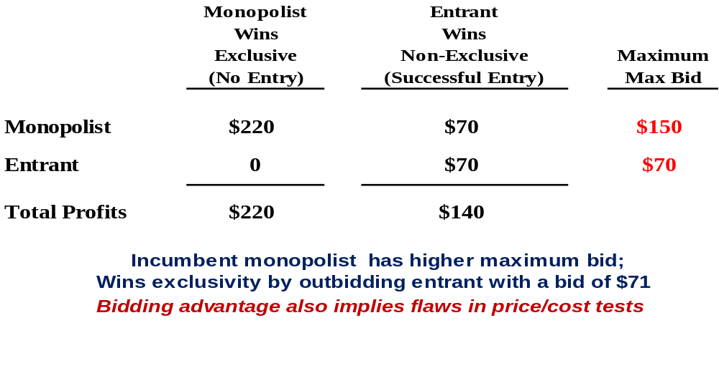
Illustrating Monopolist’s Bidding Advantage:
“Exclusion Value” of Maintaining Market Power

Slide 33
What if Excluded Rival is Less Efficient Than the Monopolist?
Should That Matter?
Some argue that only “equally efficient” competitors are deserving of antitrust protection
But, given consumer welfare standard ….
  Less efficient competitors are critical to the competitive process
  Successful entry into monopoly market (or threatened/potential entry) by a less efficient entrant causes prices to fall and consumers to benefit
  The less efficient entrant may soon become an equally (or more) efficient competitor, once it becomes established
This argument conceivably could apply under aggregate welfare standard
  But under this standard, the harms to the competitors are counted in the welfare balance

Slide 34
Moderate Entrant Variable Cost Disadvantage Constrains the Potential Price Increase: “Limit Pricing”
Diagram shows rapid entrant with a cost disadvantage C_{E} > Cm, but its variable costs C_{E} are less than the monopoly price Pm. So, the monopolist (or merged firm) cannot ignore the potential of entry.
If it faces a threat of entry from this entrant, its price increases are limited to a price level (slightly) below the entrant’s variable costs.
This price is called the “Limit Price.”
If C_{E} → Cm, then monopolist (or merged firm) cannot raise even by a SSNIP.
P_{m}
m
C_{E}
P_{L}
C_{m}
Q_{m}
Q_{L}
But recall the key assumption of No Sunk Costs.
If there are Sunk Costs, then the “price war” model applies instead.

Slide 35
Customer Foreclosure
Lorain Journal

Slide 36
Customer Foreclosure:
Lorain Journal (1951)
Conduct?
  Dominant newspaper (Lorain Journal) threatened refusal to deal with advertisers who patronized new radio station (WEOL)
  Essentially “coerced” exclusive dealing
Effects?
  Advertisers refused to deal with WEOL
  WEOL’s revenues were cut-off/reduced
  Journal maintains monopoly advertising prices
Key to Analysis
  Exclusivity cut off WEOL’s “blood stream” of ad customers and ad revenue
  And… no cognizable efficiency justification

Slide 37
Customer Foreclosure to Harm Advertisers:
Lorain Journal
Lorain Journal
WEOL
Advertisers
Lorain Journal “coerces” advertisers to stop dealing with WEOL by requiring all-or-nothing contract, reducing WEOL’s demand and leading WEOL to fall below MVS and exit, allowing Lorain Journal to maintain monopoly power over those advertisers.

Slide 38
Alternative Hypothetical: Target Only Smaller Advertisers for Higher Prices
Key Advertisers
(as foreclosed input)
Lorain Journal
WEOL
Small Advertisers
(as harmed consumers)
Lorain Journal coerces exclusives from large “key” advertisers, which kills WEOL and allows it to achieve or maintain monopoly power over other smaller advertisers. (Large advertisers are like an “input.”)

Slide 39
Alternative Hypothetical: Target Some Advertisers to Maintain
Market Power Over Other Advertisers
Exclusive
Advertisers
(A,B,C)
Lorain Journal
WEOL
Oher Advertisers
(D, E, F)
Lorain Journal is able to coerce exclusives from advertisers D, E, F because its exclusives with advertisers A,B,C drive WEOL below MVS.
(Advertisers A,B,C are like the input and Advertisers D,E,F are the consumers.)

Slide 40
Can WEOL and Advertisers Protect Themselves?
  Why is antitrust necessary?
    Why can’t WEOL cut price?
    Why wouldn’t advertisers resist?
  “Self-Fulfilling” Expectations
    Suppose WEOL offers a large discount for non-exclusivity
    Suppose Journal offers no discount, but threatens higher future prices for non-loyalists – a “penalty price”)
    Most advertisers may accept the Journal’s offer in the expectation that WEOL will fail to attract enough other advertisers to survive
    As a result, WEOL fails from these “self-fulfilling expectations”
  Competition as a “Public Good”
    Why does the market fail to self-correct?
    Advertisers cannot easily “coordinate their defense” to the coercion
    Competition is a “public good”

Slide 41
Explaining the Self-Fulfilling Expectations Equilibrium:
Numerical Example
Suppose initial monopoly price is $100
WEOL offers a price at a level just above its costs – say $50 price
Will the Journal match the price?
Instead of matching, suppose the Journal offers the following deal:
  If you buy exclusively from me in a long-term contract, I will charge you $100
  If you buy from WEOL and it fails, I will charge you a price of $150.
What will customers do?
  WEOL price is lower
  But if WEOL fails, they will have to pay $150
  So, continue to buy from Journal if believe WEOL will fail with probability of less than 50% (in which case, the “expected” price would exceed $100)
What probability to assign to WEOL failure?
  Quality of WEOL
  But, most importantly, what will other customers do?
  If each assumes that other customers will abandon WEOL, then it makes sense for every customer to do so
Thus, “expectations” rule. If customers believe WEOL will fail, then it will fail.

Slide 42
Input Foreclosure in “2-Sided Platform” Market:
Harm to both (1) Subscribers and (2) Advertisers
Coerced Advertisers
Lorain Journal
WEOL
Newspaper Subscribers
Lorain Journal “coerces” advertisers to stop dealing with WEOL by requiring all-or-nothing contract, leading WEOL to fall below MVS and exit, allowing Lorain Journal to charge monopoly advertising prices. Now, if the Journal has all the ads, then it also can maintain monopoly power over newspaper subscribers, who otherwise would get news and ads over the radio.

Slide 43
Sidebar: 2-Sided Platforms
A 2-sided platform is one where the seller has 2 revenue streams from different types of customers, and the customers’ demand on each side are “interdependent” (linked)
Examples
  Newspapers: subscribers and advertisers
  Search engines: users and advertisers
  Operating systems: users and applications developers
  Credit card networks: card holders and merchants
Firms in 2-sided markets set prices and other conduct
to take into account the interdependence
These markets often have “network effects”
  I.e., demand by customers on each side rises if more customers on the other side.
  E.g., credit card users prefer more merchants accepting the card; merchants prefer cards used by more users
Two-sidedness makes the analysis of exclusionary conduct more complex
Advertisers demand for ads on Google vs Bing depend on the number of searchers, and vice versa. CV
Credit card charge merchants a fee; charges users an interest rate, annual fee and perhaps give rebates
2-sided markets figure in several key cases and investigations: Microsoft, American Express, Visa, Google

Slide 44
Summary of Economic Analysis
Two Kinds of Anticompetitive Conduct Mechanisms
  Collusive
  Exclusionary
Two Exclusionary Conduct Paradigms
  Raising Rivals’ Costs
  Predatory Pricing
  Greater concern about RRC conduct
Four-step ROR analytical framework focuses on overall impact on consumers
  Step 1: Harm to competitors (RRC or RRR)
  Step 2: Harm to consumers (POP; recoupment)
  Step 3: Efficiencies
  Step 4: Overall competitive effect
Each step involves fact-intensive inquiry
In predatory pricing, low prices causes RRR; recoupment is POP;
efficiencies are assumed

Slide 45
Further RRC Foreclosure Examples:
Tech and Non-Tech

Slide 46
Radiant Burners v. Peoples Gas (1960)
The “input” foreclosed might be a product certification
  Radiant invented a new efficient gas burner that used less natural gas
  In order to satisfy municipal building codes, the burner needed to be safety certified by the standard setter, which was the American Gas Assoc, make up of municipal gas companies
  The AGA members feared that use of the Radiant burner would somewhat reduce the demand for gas
  Radiant was denied the certification
Radiant sued and won. The Supreme Court treated this “exclusionary group boycott” by the AGA as per se illegal
Legal standard to be discussed
at Topic 21

Slide 47
Conceptualizing Radiant Burners as Input Foreclosure
No substitute certification permitted by building codes
AGA
“Certification”
Market
Peoples Gas
(& other Gas Co’s)
Radiant
Gas
Market
Consumers

Slide 48
Google Exclusion Cases
(Circa 2021)

Slide 49
Google AdTech (Texas AG et al) Case
Terminology & Mkt Structure
Google Alleged Anticompetitive Conduct
Case involves “display” ads
Publisher Ad Servers organize publisher ad sales
Demand Side Platform (DSP) organizes advertiser buys
Ad Exchange auctions off Publisher ads in real time
Prevent “interoperability” between Google Exchange and Rival Ad Servers and DSPs
Prevent “interoperability” between Rival Exchanges and Google Ad Servers and DSPs
Obtain Advertiser and Publisher Exclusives for Google Ad Servers and DSPs
Google Publisher
Ad Server
Google
Ad Exchange
Google DSP
Publishers
Advertisers
Rival Publisher
Ad Server
Rival
Ad Exchange
Rival DSPs

Slide 50
Maintenance of Search Advertising Monopoly
Monopolization of Search Advertising
Alleged anticompetitive conduct:
Creation of a Monopoly Sales Agency for Search Ads
  Profit-Sharing Payments to various entities to make Google Apps (that are used for search) the defaults
  (or exclusives) (e.g., Apple Safari, Mozilla Firefox, Wireless carriers)
  Android license restrictions on device makers to
  preload Google Apps (Chrome; Search; Maps)*
Monopoly power
  High consumer search and search advertising market shares
  Network barriers to entry
Complaint focuses only on search ads, not display ads found in newspapers, etc.
Complaint has little to say on whether Google search is a “two-sided transaction platform” for which the awkward Amex approach might apply
  * This also was part of the EU’s 2018 case against Google that led to a €4.3 billion fine
  https://www.theverge.com/2018/7/18/17580694/google-android-eu-fine-antitrust

Slide 51
Maintaining Google Search Monopoly With Exclusives
Android Licensees required to give prominence to Google search apps
Google makes profit-sharing payments to use Google search paid to Safari, Mozilla, Verizon, etc.
Google Deals
Google
websites
Android
Licensees
Browsers/
OEMs
Apple
DOJ Complaint: In 2019, almost 50% of Google search traffic originated on Apple devices. Google/Apple agreements cover ~36% of US search queries.
Default
Search
Engine
& Browser
Google
Search
Rivals
Search
Advertisements
Advertisers

Slide 52
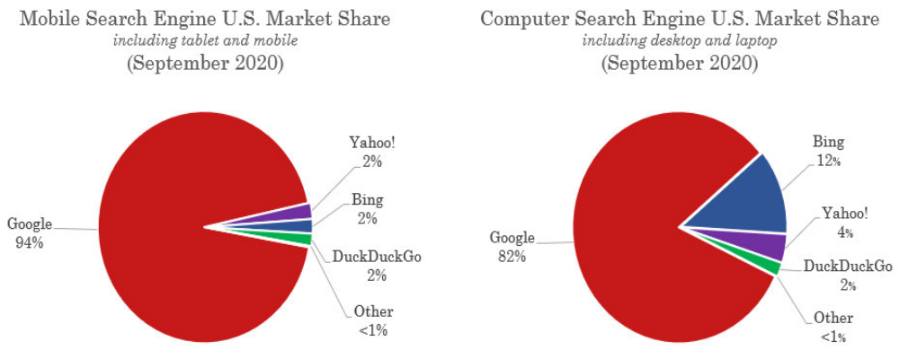
Google Search Engine Market Share

Slide 53
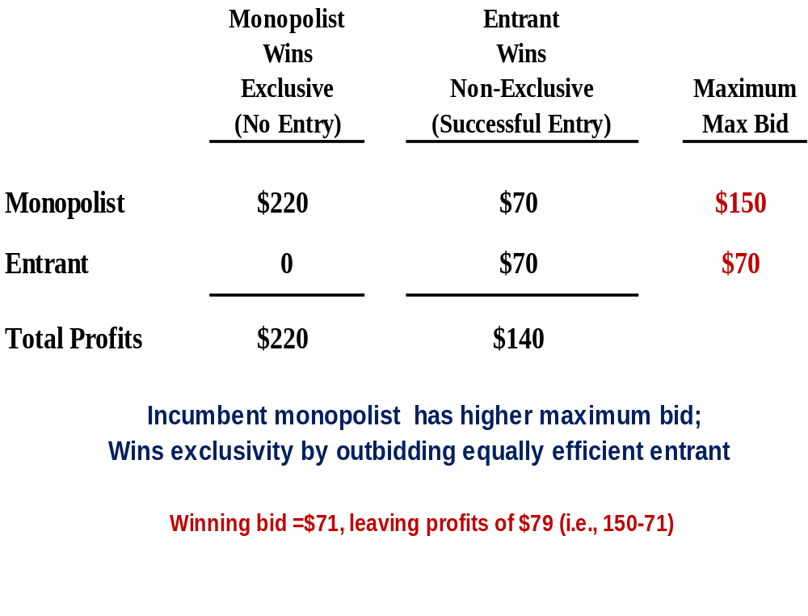
Illustrative Example: Why Rival Search Engines Cannot Outbid Google for Exclusive or Default Position
The monopolist bids to earn protect its monopoly profits. But the rival (e.g., Bing) is bidding only to achieve more competitive, duopoly profits, which is are lower.
Monopolist’s value of winning is $150. The competitor will not get a monopoly if it wins, so its value is only the duopoly profits of $70.
The monopolist wins as long as monopoly profits exceed the sum of duopoly profits. The only issue is the division of the profits between the monopolist and the distributor
But, it is not “competition on the merits.” It is distorted competition to protect a monopoly. Consumers are harmed, not benefited, because they continue to pay monopoly prices.
Note: This insight has been clear in economics for decades (e.g., Gilbert./Newberry)

Slide 54
Example: Bidding for Apple Searches
Apple may have sufficient search market share to scale competitor
60% of searches occur on mobile,
Apple controls 60% of mobile market = 36% of search
However, competitors bidding likely cannot outbid Google
Competitors would need to bid at least much as current Google payments to Apple ($8 to $12 Billion)
New competitors would start at lower quality which may impact Apple product quality / reputation / brand identity
  Apple dropped Bing as the default search in 2017 for inferior search quality*
  Apple would demand higher revenue-share payments from competitor to compensate for this loss
Google’s payments to Apple for default status was maybe 30-40% of Google likely search revenue on Apple
Search Market Overview
Search Market by
Query Volume
60%
40%
Mobile Market
N Devices
Desktop
Browser
40%
60%
16%
60%
Android
iOS
Safari
Chrome
36% + 6.4%
Total Apple Search Market Share = 42.4%

Slide 55
Some Answers to Fact Questions
Yes, they matter. If it were so easy -- why did Google pay so much to Apple ($8-12 billion; ~ 33% of Alphabet profits) for default status?
Defaults Question
Do “defaults” matter when it is so easy to download other apps or change default settings?
It would be interesting to compare prices per click for search ads vs contextual display ads. But the lesson of the “Cellophane Fallacy” is that a court should not focus on a SSNIP above the current (allegedly monopoly) price. Thus, the SSNIP test used for mergers has little use here.
It also is alleged that Google sells (and alleged has) monopoly power over contextual display ads too, which would render the standard SSNIP test inapplicable.
Note: Microsoft’s expert economist lost substantial credibility by arguing that that Microsoft lacked monopoly power
Market Definition Question
What will the court find is the relevant search advertising market? Will it include searches on Amazon?

Slide 56
Some Answers to Legal/Policy Questions
Legal/Policy Questions
Should Google be permitted to buy exclusive or default access (e.g., with profit-sharing agreements) from Apple and others for Google search? Is it just “competition on the merits?”
As the owner of Android (which is licensed for free), should Google be permitted to require preference for Google search and Chrome?
Monopolists’ conduct is examined thru a special lens. The fact that certain conduct is permissible – and procompetitive – in a competitive market does not mean that it is procompetitive when implemented by a monopolist.
The fact that there is “competition” for exclusives does not mean that it is “competition on the merits”
Google argues that this is the way it is paid for Android, i.e., that it is an “exploitive” tie, not a “foreclosure” tie, so the single monop profit theory supposedly applies. But this ignores that raising BTE into search allows Google to get mkt power over non-Android users too. (See Carlton/Waldman)
Several possibilities:
Apple enters with its own search engine. (Apple accounts for a huge fraction of searches.)
Bing buys default status -- and quickly improves because the huge increase in its scale
Huge windfall gain for Google. Google is still chosen, but now does not need to pay.
Big Fact/Policy Question
If Google were prohibited from bidding for defaults, what would be the market outcome?

Slide 57
Conduct Not Included in Complaint
EU case; FTC passed on this case in 2012. EU case in 2016. Possible next case – €2.4 billion fine
Search bias: Foreclosure of rival web sites such as Yelp;
self-preferencing behavior
Series of vertical and horizontal acquisitions to increase advertising share and prevent rivals from gaining data (e.g., YouTube, Waze)
Panoply of Google conduct to achieve and maintain monopoly in the sale (and technology/infrastructure for the sale) of display advertisements in newspapers and other websites
Possible next case

