Slide 1
Topic 12
Unilateral Effects Merger Analysis
Professor Steven Salop
Antitrust Econ & Law
Fall 2021

Slide 2
Anticompetitive Effects of Mergers – Three Types
Coordinated Effects (“Horizontal” – Merger of Rivals)
  Facilitate post-merger tacit coordination among ALL firms in the market
Unilateral Effects (“Horizontal” – Merger of Rivals)
  Facilitate exercise of market power by merged firm alone
    Merger to Monopoly; or
    Merger that eliminates competitive constraints on ability to raise price
Exclusionary Effects
  Impair rival’s access to inputs or customers/markets
  Similar analysis to all other forms of exclusion
  Secondary theory only in horizontal mergers. More important in vertical mergers
Note: A single merger can raise Coordinated and/or Unilateral Concerns;
Exclusionary Concerns can be coordinated or unilateral, and are
more central in Vertical Mergers

Slide 3
Figure 5-5:
Two Horizontal Merger Scenarios
Coordinated Effects
Unilateral Effects
Firm
A
Firm
B
Firm
C
Pre-Merger
Firm
A
Firm
B
Firm
C
Firm
AB
Firm
C
Post-Merger
Firm
AB
Firm
C
Merger of Firms A and B facilitates coordination between Firm AB and Firm C and hence the exercise of market power.
Merger of Firms A and B facilitates the exercise of market power by Firm AB alone without coordination with Firm C.
Eliminates “head-to-head” competition.
p. 798

Slide 4
Unilateral Effects vs Coordinated Effects:
Technical Distinction
Topic 12
Unilateral Effects: Enhance market power by
eliminating head-to-head competition between merging firms, even if the merger causes no changes in the way other firms behave.
Coordinated Effects: Enhance market power by
increasing the risk of coordinated, accommodating, or interdependent behavior among some or all rivals in the market .
Topic 13

Slide 5
Unilateral Effects: Introduction
Elimination of head-to-head competition between the merging firms.
Elimination of competition incentivizes price increases
Very simple and ubiquitous: Analogous to merger to monopoly– but no monopoly required – because the focus is elimination of head-to-head competition between the merging firms
Analysis of unilateral effects analytically does not rely a market to be defined:
  However, unilateral effects requires similar analysis of substitution
  If unilateral effects are high, then the 2 merging firms would by themselves comprise a separate market
But this raises some questions (to be addressed):
  Why does Section 7 require a market definition for unilateral effects concerns?
  Why doesn’t this concern make all horizontal mergers per se illegal?
  What factors limit price increases?
  How to gauge pricing incentives?

Slide 6
Glossary of Unilateral Effects Concepts:
For Later Reference
Term
Definition
Critical Loss Analysis (“CLA”) | Analysis of the magnitude of lost sales that would make it profit-maximizing (or not) for the hypothetical monopolist to impose a particular SSNIP.
Diversion Ratio (“DR”) | The diversion ratio from Product 1 to Product 2 is defined as the percentage of unit sales lost by Product 1, when its price rises, that are captured by Product 2.
Upward Pricing Pressure (“UPP”) | The incentive to raise prices emerging from acquisition of a close competitor. This UPP is measured as the “value of diverted sales” and the GUPPI
Downward Pricing Pressure (“DPP”) | The incentive to lower prices resulting from cost savings generated from a merger.
Gross Upward Pricing Pressure Index (“GUPPI”) | The value of diverted sales divided by the lost revenues attributable to a price increase in product 1.
Value of Diverted Sales (“VDS”) | The number of units diverted from one product sold by the merging firms to a second of its products in response to a price increase on the first product, multiplied by the dollar margin between price and incremental cost on the second product. The value of diverted sales can be interpreted as a measure of the extra (opportunity) cost the merged firm bears in selling more units of Product 1.

Slide 7
Kraft (1995): A First (but unsuccessful) Unilateral Effects Case
Merger of Post and Nabisco Cereals
“Grape Nuts” & “Shredded Wheat” Brands
Note: Case brought by New York State AG

Slide 8
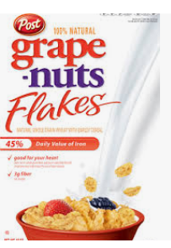
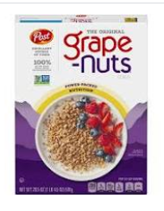
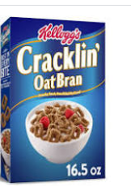


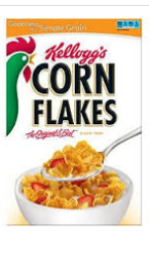
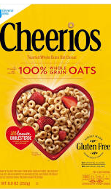
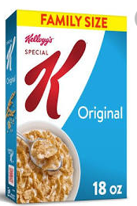
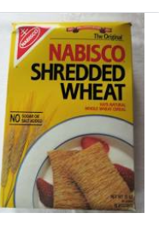
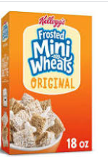
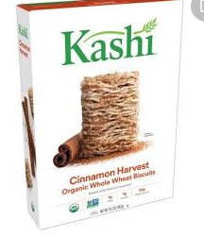
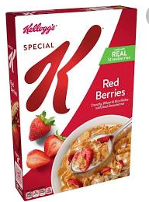
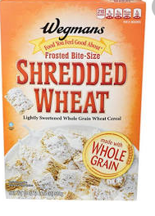
Differentiated Cereals: Grain, Shape (“Mouth-Feel”), Sugar, Flavors, “Positioning,” Organic, Price
Some Close Competitors
Cereal Mkt Leaders
Brand Extensions
Merging Firms
Private Label

Slide 9
Kraft (1995) Cereals Case – Evidence (pp. 826-827)
Conclusion: “Grape Nuts and Nabisco Shredded Wheat compete with many other products and
are not the first and second choices of a significant number of consumers.”
At least five different types of evidence were analyzed.
Extent to which the two brands had similar physical characteristics and images.
  Grape Nuts and Nabisco Shredded Wheat differed in physical characteristics and that the two brands emphasized different attributes in their advertising. Grape Nuts was marketed first as “healthy” and later as “energy sustaining;”
  Nabisco Shredded Wheat was marketed as “pure,” with no added sugar or salt. Many other cereal brands were also promoted as healthy, plain cereals, such as Corn Flakes, Cheerios, Chex, Special K, Total, and Rice Krispies.
Customer testimony about the extent of buyer substitution between the brands.
  Executives of two large grocery retailers testified that they did not consider Grape Nuts and Nabisco Shredded Wheat to be particularly close competitors, and that they set the retail price for the two brands independently.
Marketing survey data about the characteristics of each brand’s customers.
  Grape Nuts consumers tended to be “upscale,” younger, and more educated, while Nabisco Shredded Wheat consumers tended to be “downscale,” older, and less educated.
Extent to which the merging firms monitored and responded to key marketing decisions of each other.
  Some Post documents indicated that the two brands were viewed as at or near the top of each other’s list of most direct competitors.
  But evidence also showed that Post generally looked to Kellogg products, not Shredded Wheat, as a pricing benchmark for Grape Nuts
  Evidence did not support plaintiff’s assertion that Post tracked Nabisco Shredded Wheat’s pricing, advertising, and promotional activities to determine expenditures for Grape Nuts.
Econometric study of buyer demand conducted by defendant’s expert economist.
  Low cross-price elasticities of demand between Grape Nuts and Nabisco Shredded Wheat,
  Cross-price elasticities of demand were higher between Grape Nuts and a number of other cereals, including Cheerios, Kellogg’s Raisin Bran, Kellogg’s Frosted Mini-Wheats, the Kellogg’s Nutri-Grain line, and Ralston Chex
Cereals have different “mouth feel.”

Slide 10


The First Successful Unilateral Effects Case:
Staples (1997) (p. 779)
Staples Opinion focuses on market definition
  But unilateral effects was the driving force!
Unilateral effects theory
  Merged firm will have unilateral incentive and ability to raise prices, even if rivals do not follow by raising their own prices
  Staples, Depot and Max are closest (differentiated) substitutes
Relevant product market
  FTC: “sale of consumable office supplies through office superstores”
  Parties: “all office products” sold anywhere → 5.5% share
  Geographic markets were local
Key role of “direct evidence” (actual prices, depending whether Staples and Depot competed)
  “Natural experiment”
  Used Scanner pricing data across geographies and over time
  Evidence also included internal pricing documents and other evidence of pricing conduct
This is what makes it “unilateral” rather than “coordinated”

Slide 11
Staples Unilateral Effects and Market Definition Evidence
Essentially an Integrated Approach
  Effects empirical evidence & market definition evidence identical
  Evidence Reinforcing: Proof of anticompetitive effects also proves narrow market definition and high concentration
Clearly close head-to-head competitors
  Similar (and unique) store layouts and targeted customers
  Monitor each other and define price zones around each other
Actual Pricing Data – Natural experiments
  Prices lower when there was competition among superstores
  Prices not lower when there was more non-superstore competition (Walmart, etc)
  Reduce prices when entry of rival superstore (or when anticipate entry)
HHI high (given narrow product market definition flowing from pricing and other evidence)
  3-2 or 2-1 in various local markets

Slide 12
Staples Pricing Evidence
Same evidence as for Mkt Dfn
“Much of the evidence already discussed with respect to defining the relevant product market also indicates that the merger would likely have an anti-competitive effect.”
The evidence of the defendants’ own current pricing practices, for example, shows that an office superstore chain facing no competition from other superstores has the ability to profitably raise prices for consumable office supplies above competitive levels. The fact that Staples and Office Depot both charge higher prices where they face no superstore competition demonstrates that an office superstore can raise prices above competitive levels.
The evidence also shows that defendants also change their price zones when faced with entry of another office superstore, but do not do so for other retailers. Since prices are significantly lower in markets where Staples and Office Depot compete, eliminating this competition with one another would free the parties to charge higher prices in those markets, especially those in which the combined entity would be the sole office superstore.
In addition, allowing the defendants to merge would eliminate significant future competition. Absent the merger, the firms are likely, and in fact have planned, to enter more of each other’s markets, leading to a deconcentration of the market and, therefore, increased competition between the superstores.
In addition, direct evidence shows that by eliminating Staples’ most significant, and in many markets only, rival, this merger would allow Staples to increase prices or otherwise maintain prices at an anti-competitive level.
The merger would eliminate significant head-to-head competition between the two lowest cost and lowest priced firms in the superstore market. Thus, the merger would result in the elimination of a particularly aggressive competitor in a highly concentrated market, a factor which is certainly an important consideration when analyzing possible anti-competitive effects. * * * It is based on all of this evidence as well that the Court finds that the Commission has shown a likelihood of success on the merits and a “reasonable probability” that the proposed transaction will have an anti-competitive effect.
ALSO – Eliminate Future Competition
Direct Pricing Evidence
Eliminate Head –to-Head Competition

Slide 13
Merger “Price Effects” (p. 783, footnote 14)
There has been tremendous argument regarding whether the FTC actually contends that prices will go up after the merger. The Court understands that is not precisely the Commission’s contention. Rather, the Commission argues that the merger will have an anti-competitive effect such that the combined firm’s prices will be higher after the merger than they would be absent the merger.
This does not necessarily mean that prices would rise from the levels they are now. Instead, according to the Commission, prices would simply not decrease as much as they would have on their own absent the merger. It is only in this sense that the Commission has contended that prices would go up—prices would go up compared to where they would have been absent the merger.
“Absent the merger” is
“But-For World”
See next slide

Slide 14
What Do We Mean by Claim that Merger Will Raise Prices?
The Debate
  Staples argued that it reduced price every year and would continue to do so after the merger.
  FTC’s winning response: Price will be higher than absent the merger
Bottom line: Price effects should be measured relative to the “but-for world”
(i.e., “but for” the merger)
Price
Merger Price Impact
Post-merger
But-for World
Merger
Time

Slide 15
HMGs Analysis

Slide 16
Unilateral Incentive to Raise Prices (HMGs § 6.1):
Basic Economics
Products of merging firms are close substitutes: “In differentiated product industries, some products can be very close substitutes and compete strongly with each other, while other products are more distant substitutes and compete less strongly.
Unilateral price increase by one (or both) products: A merger between firms selling differentiated products may diminish competition by enabling the merged firm to profit by unilaterally raising the price of one or both products above the pre-merger level.
Merger partner “recaptures” diverted Sales: Some of the sales lost due to the price rise will merely be diverted to the product of the merger partner and, depending on relative margins, capturing such sales loss through merger may make the price increase profitable even though it would not have been profitable prior to the merger.”
This effect occurs even if rivals do not follow the price increase, which is why it is called “unilateral” effects.
For this same reason, market definition is not key.
The merging firms’ product actually do not need to be “closest” substitutes to each other
“Recapture” of the “Diversion” is Key. This also is the foundation of the “recapture percentage” in market definition
But competitors generally will at least partially follow the price increase
(multi-lateral effect)

Slide 17
Impact of a Merger That Leads to Diversion of Some Lost Sales to the Merger Partner. Consider a Price Increase Above the Profit-Max Price $200 Up to $220
BEFORE THE MERGER, THE PROFIT FOR
STANDALONE “FIRM 1 DECLINES WHEN IT RAISES PRICE TO $220
“
AFTER THE MERGER, THE “RECAPTURE” OF 8 UNITS OF SALES LOST BY ITS MERGER PARTNER MEANS THAT COMPANY PROFITS WOULD INCREASE WHEN IT RAISES PRICE
$220
P₂
Recapture R
Gain
If Gain = ~ Loss for Firm 1
before the merger,
Then Gain + Recapture > Loss
after the merger.
$200
P₁
R
Loss
$110
C
Q₂
92
Q₁
Recaptured Sales = 8
Assume Firm-2 (dollar) margin = $90
(Margin same as Firm-1)
80
100

Slide 18
The “Value of Diverted Sales” (VDS)
VDS is the key concept in unilateral effects analysis
VDS is the incremental (dollar) profits earned by merging firm-2 on firm-1’s lost sales that are recaptured when merging firm-1 raises price.
Why so important?
  In the pre-merger world, firm-1 treated those sales simply as losses to itself, and those losses constrained its incentive to raise price
  But, in the post-merger world, the merged firm realizes that those sales are
  not lost, but merely transferred from merging firm-1 to merging firm firm-2.
  So, they no longer constrain price increases by firm-1
  Thus, the merger incentivizes price increases by the merged firm
VDS = firm-2’s dollar margin x recaptured sales from firm-1
VDS Example: dollar margin = $90; recaptured sales = 8;
VDS = $90 x 8 = $720
This difference is the effect of the merger
Based on numbers from previous slide
Dollar margin is “price less marginal cost.”
Percentage margin is dollar margin as a percentage of price = (P-MC)/P

Slide 19
Economic Background Sidebar
Diagrammatic Analysis of
Profit-Maximization for a Single Firm and Unilateral Effects

Slide 20
Figure 1: Pre-Merger Profit-Maximization Outcome for Firm-1 is shown as Price = $200
Profits
C
P*
Price
$200

Slide 21
We next show the calculation of the profitability of price increases, beginning at the perfectly competitive price of $110 (price = marginal cost + $110)

Slide 22
Figure 2: Firm’s Profit from Increasing Price to $120 (Above the Competitive Level)
Competitive Price P₀ = cost = $110
Competition Profit = 0
Suppose increase price to $120
Unit sales fall from 200 to 150.
Profits rise to (P₁-110)Q1 = $1500
Profit Gain (G) = $1500
The reduction in unit sales does not reduce profits since the competitive profit “margin” = (P₀-MC) =0
$120
P₁
Gain
G = $10 x $150 = $1500
C
$110
P₀
Marginal Cost (MC)= $110
Q₁
Q₀
150
200

Slide 23
Figure 3: Increased Profit From Increasing Price From $120 to $140
Suppose increase price to $140
Unit sales fall from 150 to 140.
Profit @ $140 = (P₂-110)Q₂ = (140-110)140 = $4200
Profit @ $120 = (P₁-110)Q₁ = (120-110)150 = $1500
Profit Net Increase = $2700
G = $20 x 140 = $2800
$140
P₂
“Gain” = $20 higher price earned on the 140 sales that remain = $2800
“Loss” = $10 profit margin sacrificed from 10-unit reduction in sales = $100
Net = Gain – Loss = $2700
Gain
L = $10 x 10 = $100
$120
P₁
Net = G - L =$2700
Loss
P₀
C
$110
Q₂
Q₁
Q₀
140
150
200

Slide 24
At some point, further price increases will reduce profits.
This will determine the profit-maximizing price.

Slide 25
Figure 4: Decreased Profit From Increasing Price
from $200 to $220
Suppose increase price from initial price $200 up to $220
Unit sales fall from 100 to 80.
Profit @ $200 = (P₂-110)Q₂ = (200-110)100 = $9000
Profit @ $220 = (P₁-110)Q₁ = (220-110)80 = $8800
Profit Net Decrease = - $200
G = $20 x 80 = $1600
$220
P₄
“Gain” = $20 higher price earned on the 80 sales that remain = $1600
“Loss” = $90 profit margin sacrificed from 20-unit reduction in sales = $1800
Net = Gain – Loss = - $200
Gain
$200
P₃
L = $90 x 20 = $1800
Net = G - L = -$200
Loss
$110
C
Q₄
Q₃
80
100

Slide 26
Figure 5: If $200 is the Profit-Max Price Level, a “Very Small” Price Increase Only Reduces Profits by a “Very Small” Amount:
Consider a Price Increase from $200 to $201
That is, suppose $200 is Top of the Profit Hill in
Figure 1
G = $1 x 98.8 = $98.80
P₅
$201
“Gain” = $1 higher price earned on the 98.8 sales that remain = $98.80
“Loss” = $90 profit margin sacrificed from 1.2-unit reduction in sales = $108
Net = Gain – Loss = - 9.20
Net Loss is Pretty close to Zero
Gain
$200
P₃
L = $90 x 1.2 = $108
Loss
$110
C
Q₂
Q*
98.8
100

Slide 27
Figure 6: The Loss is Small Because the Region Near the
Top of the Hill is Relatively “Flat” (Maximum Profits)
Profits
C
P₃
P₅
Price
$200
$201

Slide 28
Suppose now that this Firm-1 merges with Firm-2.
How will the profitability of Firm-1’s price increases change?
Answer: The merger increases profitability
Why? Because some of the customers lost by Firm-1 will “divert” to Firm-2, which allows “recapture” of the profits had earned on those customers.
f

Slide 29
Figure 7: Impact of a Merger That Leads to Diversion of 8 of Firm-1’s Lost Sales to the Merger Partner. Consider a Price Increase from the Profit-Max Price $200 Up to $220
RECALL THAT BEFORE THE MERGER, THE PROFIT FOR STANDALONE “FIRM 1 DECLINED WHEN IT RAISE PRICE TO $220
“Gain” = $20 higher price earned on the 80 sales that remain = $1600
“Loss” = $90 profit margin sacrificed from 20-unit reduction in sales = $1800
Net = Gain – Loss = - $200
Suppose now 8 of the 20 sales that lost by Firm 1 divet to Firm-2, when Firm-1 raises price
If Firm 2 also has a profit margin of $90 per unit, the
Lost Profits “Recaptured “ = $90 x 8 = $720,
This “Recapture” exceeds the profits lost (i.e., $200) by Firm 1.
Thus, the merger makes the price increase profitable on balance!
The merged firm has the incentive to raise price, though the standalone
Firm 1 did not. (The same analysis would apply to price increases by Firm 2.)
The HMGs call the Recapture Profits the “Value of Diverted Sales.”
This incentive to raise price is even stronger for the $1 price increase,
Because the Net Loss to Firm 1 was de minimis.
$220
P₄
Recapture R
Gain
$200
P₃
R
Loss
$110
C
Q₄
92
Q₃
80
100
As shown in the diagram, if Gain = ~ Loss for Firm 1 before the merger, then Gain + Recapture > Loss after the merger.

Slide 30
Profit-Maximization Economics & the Value of Diverted Sales:
The Merger of Crunchies & Fruities (pp. 829-32)
This will be the same economic analysis as in the slides, but in Table form

Slide 31
Crunchies Pre-Merger Profit-Maximization
The Facts:
  Crunchies sells 100 boxes of cereal for $2/box
  Each box costs $1.10 to produce
  The contribution margin is thus $0.90 per box and Crunchies currently earns $90.00 in profits (100 boxes x $.90)
  If Crunchies raises its price by 5% to $2.10, suppose that it loses 10% of sales
    90/100 customers pay the higher price,
    but it will lose 10/100 of its customers.
Pre-Merger:
  Crunchies maximizes profits at the pre-merger price of $2.
  Therefore, a further price increase will not Increase Crunchies’ Profits (Illustrates “Critical Loss”)
  In fact, a “very small” price increase would pretty much keep profits at the same level; no gain or no loss
    I.e., Lost Profits from Sales Lost = Increased Profits from Higher Prices to Customers Retained
  See Next Slide for details
Key assumption – to be shown on next slide

Slide 32
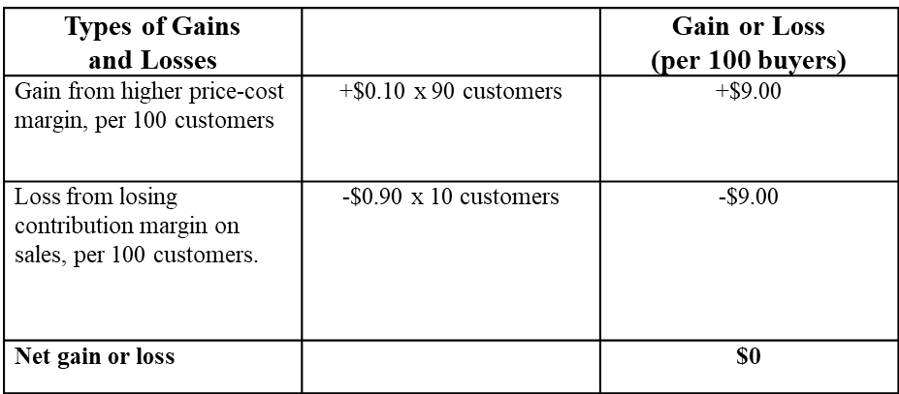
Crunchies Standalone Profit-Maximization
Note: Unlike the earlier Econ Sidebar in this deck, this example is simplified to have identical profits after the price increase, I.e., Gains = Losses exactly
Pre-merger: No ability to increase profits, so no incentive to raise price

Slide 33
The Merger of Crunchies & Fruities
What if Crunchies acquires Fruities? How will profits change?
Added Facts:
  Assume that when Crunchies tried to raise price, 3/10 lost customers switch to Fruities
  (i.e., “diversion ratio” = 30%)
  Assume also that Fruities already sells for $2.10/box and its costs are $1.30, so its contribution margin is $0.80/box
  If Crunchies acquires Fruities, and raises the price of Crunchies to $2.10,
  Crunchies profits will not change (or fall only slightly):
    It will sell 90 boxes of Crunchies for $2.10, increasing its profits on Crunchies by $9.00;
    But, it will lose $9.00 in profits because 10 customers will no longer buy Crunchies (as previously);
  BUT – Merged firm will gain $2.40 of additional profits from selling 3 extra boxes of Fruities (margin $0.80 x 3 units= $2.40).
    See next slide for profit summary
I.e., Crunchies is at the top of the profit hill. (This example has G=L exactly!)
This $2.40 is the Value of Diverted Sales

Slide 34
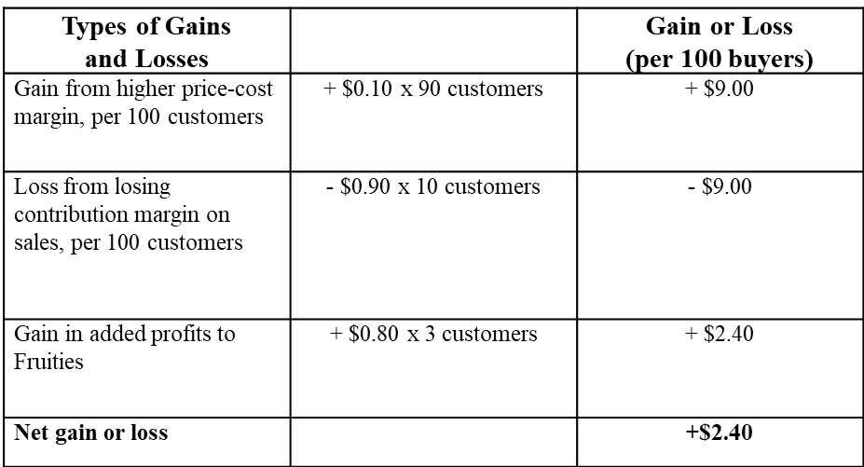
The “Value of Diverted Sales”
The acquisition of Fruities by Crunchies will give it the incentive and ability to raise the price of Crunchies, because it will recapture 3 of its previously diverted sales.
Note: This “Net Gain” is the HMGs’ concept of “value of diverted sales”

Slide 35
“Scoring” Upward Pricing pressure With the GUPPI
(Gross Upward Pricing pressure Index)

Slide 36
GUPPIs vs VDS
GUPPI = Gross Upward Pricing Pressure Index
The GUPPI is a “scaled” version of the Value of Diverted Sales (VDS) to make it a percentage
  Diversion Ratios, Percentage Margins and Prices are Used to Calculate the GUPPIs
GUPPIs are used as an initial, rough screen of UPP in the HMGs.
Other GUPPI flavors or simulation models can also take into account changes in those prices, as well as constraints from entry and downward pricing pressure from merger-efficiencies [as discussed below]
Inside Baseball:
The GUPPI definition is hidden in the 2010 HMGs and the GUPPI is never “named.”

Slide 37
Calculating the GUPPI
Dollar margin is “price less marginal cost.”
Percentage margin is dollar margin as a percentage of price = (P-MC)/P
Derivation
  In the Crunchies example, the “Value of Diverted Sales” (VDS) to Fruities was $2.40
  The GUPPI converts the VDS into a ratio formula
  GUPPI Formula:
GUPPI₁ = DR₁₂ x M₂ x P₂ /P₁
  DR₁₂ =Diversion ratio from firm-1 to firm-2 if firm-1 raises price (i.e., fraction of sales lost by firm-1 that are recaptured by firm-2) (e.g., 30%)
  M₂ = firm-2’s contribution margin -- as a percentage of its price
  (e.g., $0.80/$2.10 = 38%)
  P₂/P₁ = price ratio of the two products (e.g., $2.10/$2 = 1.05)
  GUPPI₁ =30% x 38% x 1.05 = 12%
DR and M are percentages, unlike the VDS formula, which uses dollars
See Optional Technical Appendix for Derivation

Slide 38
Application to Whole Foods/Wild Oats Merger
Historical (“natural experiment) evidence showed that exits of Wild Oats store delivered 33% of lost WO sales to Whole Foods and 67% to conventional stores
  Implies “Diversion Ratio” DR₁₂ = 33%
WF store price -variable cost percentage margin = ~30% (on average)
  Implies “Percentage Margin” M₂ = 30%
Assume that WF and WO have approximately the same prices
  Implies “Price Ratio” P₂/P₁ = 1
GUPPI₁=DR₁₂ x M₂ x P₂ /P₁ = 33% x 30% x 1 = 10%

Slide 39
Some GUPPI Properties
There are GUPPIs for post-merger price increases by each of the merging firms
GUPPIs are equal to the magnitude of marginal cost reduction needed
to undo the incentive to raise price
Notable property: If demand curves are straight lines (“linear”), then the GUPPI is twice as large as the “first round” incentive to raise price from the merger
  I.e., If WF GUPPI=10%, then it would have the incentive to raise first-round price by 5%
  First round means assuming that merger partner & rival firms are assumed not to change their prices
The GUPPI is a conservative measure of pricing incentives of the merged firm
  “First-round” only
  Of course, merger partner usually also will have the incentive to raise price
  Thus, the incentive for each firm to raise both their prices will be larger than the GUPPI
  Rivals often also will have incentives to raise their prices in response (“multi-lateral” effects)
But …. GUPPIs also ignore potential offsetting effects of aggressive competitive responses by rivals, repositioning, entry and efficiencies
  Competitors may take the opportunity to expand, rather than follow the price increases
  Entry and repositioning can constrain and mitigate price increases
  Efficiencies create downward pricing pressure, which offset and even reverse price increases
This is a key property because it focuses attention of the efficiencies (i.e., DPP) required to offset the UPP

Slide 40
GUPPIs vs HHIs as an Initial “Screen” For Unilateral Effects
GUPPIs now are routinely calculated as initial screen in
HSR investigations and counseling
GUPPIs are a more relevant screen for unilateral effects than are HHIs
  Since the only issue is head-to-head competition,
  market shares of rival firms are not really required.
GUPPIs could be used for “quasi-safe harbors” and anticompetitive presumptions
  Potential quasi-safe harbor: Both GUPPIs <5%
  Potential anticompetitive presumption: Both GUPPIs >10%
    WHY 10%???
But, no GUPPI “screen” in HMGs
2010 HMGs say this. But they still rely on the HHI screens
2010 HMGs did not adopt a GUPPI presumption
A later speech by the Econ Deputy AAG who was a key drafter of HMGs “suggested” a 5% safe harbor, but not implemented

Slide 41
Why 10%? GUPPIs and Market Definition
Unilateral effects analysis does NOT require markets to be defined as a matter of formal analytics
  The focus is head-to-head competition, not all the firms in the potential market
  Substitution analysis is similar, however
If there are substantial unilateral effects shown by GUPPIs, then the two merging firms by themselves would satisfy the HMT for market definition (as follows):
  Unilateral effects analysis assumes that other firms do not change their prices
  So if the merged firm would have the incentive to raise one or both prices by at least the SSNIP (e.g., 5%), then the HMT is satisfied.
If both GUPPIs exceed 10% (and demand curves are straight lines), the merged firm would have the incentive to raise both prices by more than 5%.
And note that this implies that the two-firm market would satisfy the HMT for a separate market.
As we saw in Staples
The “recapture percentage” formula for mkt dfn for 2 firms is equivalent to the a GUPPI involving simultaneous uniform price increases by both merging firms. For that reason, GUPPIs somewhat less than 10% would satisfy the formula.

Slide 42
Gauging DRs and GUPPIs: Evidence Checklist
Note similarity to market definition evidence – No surprise since both focus on buyer substitution.
Product Characteristics (e.g., functional similarities)
Evidence of customer preferences (as in market definition)
  Customer RFPs
Evidence of switching behavior (HMG §6.1)
  Internal documents
  Consumer historical purchasing and switching patterns (best if in response to OSS reports (including bidding situations; win/loss data)
  Econometric estimates of DRs/demand own-price and cross-price elasticities (e.g., econometric analysis based on scanner data)
Diversion Ratios (DRs) and GUPPI scores
  Data on DRs, Margins, Prices needed
Other evidence of direct competition
  Competitor analysis (Strategic plans; SWOT analysis: SWOT = {Strengths, Weaknesses, Opportunities, Threats}
  Competitive monitoring
  Pre-merger pricing responses and other competitive interaction (responses in pricing, advertising, and quality
  3rd party industry analyses of the industry (e.g., trade press; analyst reports; industry consultant reports)
  Evidence of impact of merger on unilateral incentives
  Merger plans (e.g., pricing; brand rationalization/elimination/repositioning; entry/exit; innovation)
Natural experiments
  Impact on diversions: e.g., impact of price changes; shortages; entries/exits of brands (HMG §2.14)
  Impact on prices: e.g., price effects of entries or exits, previous mergers; Staples-type studies

Slide 43
What “Quantifications” Come After the Simple GUPPIs?
“Simple” GUPPIs hold constant the price of the other merging firm and rivals’ prices
“Simultaneous” (and “Uniform”) GUPPIs can be calculated to take into account “joint” price increases of both merging firms, but still holding constant the prices of rivals at the pre-merger level (Simultaneous Uniform GUPPIs exceed Simple GUPPIs)
Equilibrium Simulation Models can incorporate the “multi-lateral” price responses of rivals to accommodate the merging firms’ price increases,
and the further impact on the prices of the merging firms
Full competitive effects analysis includes other relevant issues
  Buyer power to countervail market power
  Potential expansion and repositioning by rivals; and entry by new competitors (HMGs §9)
  Impact of efficiencies (DPP) on incentives of merging firms (HMGs §10)
Topic 14
Topic 15

Slide 44
The Role of “Powerful Buyers” in Mitigating or Preventing Unilateral Effects
Powerful buyers may be able to deter anticompetitive effects from a merger
  “Countervail” unilateral effects with their bargaining power
  Sponsor new entry, or enter themselves (or threaten to do so!)
  Disrupt coordinated effects (more generally)
But, the constraining role of countervailing bargaining power effect may be unclear
  Merger increases merged firm’s relative bargaining leverage
  (i.e., relative to pre-merger) so buyer has less ability to constrain than before the merger; all those conducts existed pre-merger too
  The powerful buyer’s conduct may only protect itself, not other buyers,
  Or worse: The powerful buyer may use its bargaining power to induce sellers to raise the costs of its rivals, rather than reduce its own costs, which could even magnify the competitive harms.
To be discussed below

Slide 45
What If Products Are Not Differentiated
Consumer Products Like Cereals?
So far: We have developed the analysis with differentiated products
Unilateral effects operates more broadly
Homogeneous products (e.g., steel) and firms compete by choosing output (i.e., capacity or production).
  If one firm reduces output/capacity, there will be upward pricing pressure that will be only partially mitigated by rivals’ increased output.
Negotiation markets for intermediate goods
  Firms’ products are generally differentiated in some ways (specification differences that appeal to some buyers but not others; ancillary services; speed of delivery; etc.)
  Merger leads to highest UPP if merger involves firms that are the #1 and #1 and #2 choices for certain specific customers.
  (As noted earlier, the relevant market can be as a narrow as a single customer!)
To be discussed below

Slide 46
Application to Bid & Negotiation Markets

Slide 47
Application to Bid and Negotiation Markets
Many B2B intermediate goods sold at negotiated prices, not list prices set by the seller
  It is common for sellers to respond to buyers’ RFP by bidding a price and other terms
  Competing bids may then be subject to later rounds of negotiation, rather than being only one round
Unilateral effects concerns focus on situations where the merging firms are the two lowest bidders… for example,
  Merging firm-A bids $100; merging firm-B bids $110; non-merging firms bid $114, 120 and $125
  In a Dutch Auction model, customer would purchase from firm-A but would have to pay a price just below the second-lowest bid of $110.
  If firms-A and B merge, the merger would cause the buying price up to the next-lowest bid to $114.
Thus, substantial concerns arise to the extent that the merging firms often are the two lowest bidders for many buyers
Evidence focuses on determining how often this occurs
Technical note on Dutch Auctions.
The bidders keep offering lower prices until no one bids anymore. At that point, the low bidder wins but receives the second-lowest bid, not what it bid.
With this auction, each firm has the incentive to continue to bid even down to (almost) its cost. The winner will receive a price equal to that last bid, which will equal just a bit above the cost of the second lowest cost bidder

Slide 48
Diversion Ratio Evidence in Bid/Negotiation Markets
An estimate of the “diversion ratio” will involve the fraction of the time that the merging firms are the two lowest bidders
Potential Evidence
  Firms’ “Win/Loss” data can be used to gauge how often the two merging firms were the two best bidders
  Agencies might use CIDs to customers or competitors to determine and evaluate bids made by the various firms
Absent win/loss data, market shares might be used to construct a rough proxy of the diversion ratio based on the assumption of “proportional diversion”
  Suppose market shares for firms (A,B,C) are (20%, 40%, 40%)
  Then one might estimate that B and C each would be the next-lowest bidder (next-best substitute) when A wins the bidding about 50% of the time each
  And, A was the next-best substitute for B about one-third of the time in that C wins twice as often as A. (And C would be like the next-best two-thirds of the time)

Slide 49
Summary: Unilateral Effects Checklist
Evidence of Closeness of Substitution (Diversion Ratios (DRs)
Evidence of customer preferences
  Product attributes (functional similarities and differences)
  Consumer preference surveys
  Customer RFPs
Evidence of switching behavior (HMG §6.1)
  Consumer historical switching patterns (best if in response to OSS reports (including bidding situations)
  Econometric estimates of DRs/demand own-price and cross-price elasticities (e.g., econometric analysis based on scanner data)
  Natural experiments (e.g., impact of brand entry or exit on brand sales) (HMG §2.14)
    Internal documents
    Econometric estimates of cross-elasticity and own-elasticity to estimate DR
Other evidence of Direct Competition
Natural experiments (e.g., Staples-type studies of geographic price differences; entry/exit effects on prices)
Competitor analysis (Strategic plans; SWOT analysis)
Competitive monitoring
Pre-merger competitive interaction (responses in pricing, advertising, and quality
3rd party industry analyses of the industry (e.g., trade press; analyst reports; industry consultant reports)
Evidence of Merger Impact on Unilateral Incentives
Merger plans (e.g., pricing; brand rationalization/elimination/repositioning; entry/exit; innovation)
GUPPI score
Natural experiments (e.g., price effects of entries or exits, previous mergers; Staples-type studies)
Evidence of Entry and Repositioning (Topic 14)

Slide 50
Horizontal Mergers That Create Unilateral Buyer Power Over Input Suppliers:
Procompetitive or Anticompetitive?

Slide 51
Mergers Can Create Buyer-Side Power
We previously discussed how powerful buyers unilaterally can prevent a merger among Sellers from harming buyers
Two situations
  Merger among buyers that are not competitors on sell-side but only competitors on the buy-side
  Merger among competing sellers that also are competitors on the buy-side
Buyer-side power can have an anticompetitive effect
  Merger among buyers can harms input sellers” (“monopsony”)
Buyer-side power can have a procompetitive effect on consumers
  Merger among buyers can undo seller market power (countervailing power”)
Query: Might a merger among competing sellers that also creates buyer-side power mitigate (or even reverse) harm to downstream consumers?
And if so, how should we treat the harms to the sellers (e.g., what if the sellers are workers)?
This is the more usual situation, so it will be the focus of discussion

Slide 52
Anticompetitive Buyer-Side Power (“Monopsony”) (p.773)
  Example: Beef packing merger could harm cattle ranchers, even if the packaged beef (sell-side) market is highly competitive.
  Same basic analysis applies
    Competitive harm may involve input suppliers
    Output is typically reduced, leading also to higher downstream prices and downstream consumer harm well
    But, if downstream market is large and highly competitive, consumers may not be harmed by a single merger
  But HMGs do not require showing of consumer harm for violation
  How is this justified under the “consumer welfare standard?
    Answer: “Consumer welfare” generalized to the concept of
    “trading partner welfare”
    Further Question: But what if the merger also leads to separate efficiency benefits, so that downstream consumers are benefited while input suppliers are harmed?
    The HMGs do not really address this tension. Two possible conflicting answers
      The consumer benefit is an efficiency benefit that is not cognizable because involves multi-market balancing rejected in Phila Nat’l Bank.
      Consumer effects are primary, so the merger would be viewed as procompetitive
See HMGs language on
next slide
See HMGs language on
next slide

Slide 53
2010 HMGs: Buyer Side Mergers (HMGs § 12)
“The Agencies do not view a short-run reduction in the quantity purchased as the only, or best, indicator of whether a merger enhances buyer market power. Nor do the Agencies evaluate the competitive effects of mergers between competing buyers strictly, or even primarily, on the basis of effects in the downstream markets in which the merging firms sell.”
  “Example 24: Merging Firms A and B are the only two buyers in the relevant geographic market for an agricultural product. Their merger will enhance buyer power and depress the price paid to farmers for this product, causing a transfer of wealth from farmers to the merged firm and inefficiently reducing supply. These effects can arise even if the merger will not lead to any increase in the price charged by the merged firm for its output.”

Slide 54
Looking Forward to Topic 13:
Coordinated Effects

Slide 55
Unilateral vs Coordinated Effects:
Any “accommodating” rivals’ conduct (i.e., following price increase) is ignored, even if it is the case that rivals would follow the price increase.
Unilateral Effects: Enhance market power by
eliminating head-to-head competition between merging firms, even if the merger causes no changes in the way other firms behave.
Coordinated Effects: Enhance market power by
increasing the risk of coordinated, accommodating, or interdependent behavior among some or all rivals in the market.

